Slide 1
Introduction to Azure Purview concepts
Deepthi Goguri

Slide 2

Deepthi Goguri
Database Administrator
Data Platform MVP
Co-Organizer for DEI User Group, Microsoft Data and AI South Florida User Group
Volunteer for Data Platform WIT User Group
Loves Arts and Crafts
@dbanuggets
https://dbanuggets.com/
https://www.linkedin.com/in/deepthigoguri/

Slide 3
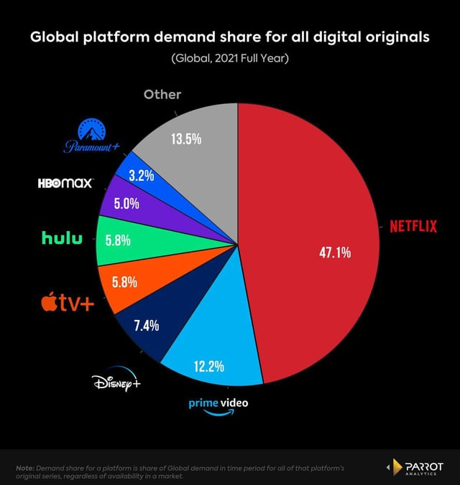
https://www.reddit.com/r/tvPlus/comments/s5s7dd/global_platform_demand_share_for_all_digital/?rdt=38923

Slide 4
Netflix uses
Post summaries
Reviews
Metadata
Content Categorization
Uses Deep learning techniques

Slide 5
Analyses user engagement data to create content production
Viewing patterns
Audience demographics
Population similar interests

Slide 6
Decision making
New projects
Allocating budgets
Predicting the success or failure

Slide 7
Data Everywhere
So much data
Data distributed across the env (Hybrid, on-prem, SaaS sources etc.)
Regulations
Different users, different roles (Data scientist, Data engineers)
Notes:
Data needs to be discovered, understood and accessible when ever we need it. Data also needs to be of the high quality. Are we using the data the right way. Are we using with in the compliance boundary so the high position leaders can understand how the business is going with out actually looking at all the data. They should be able to make the decisions based on that.

Slide 8
Microsoft Purview
Unified platform-based approach
Open source – add more types to open source apache atlas
Data needs to be discovered
High quality data
Able to be accessible to right people

Slide 9
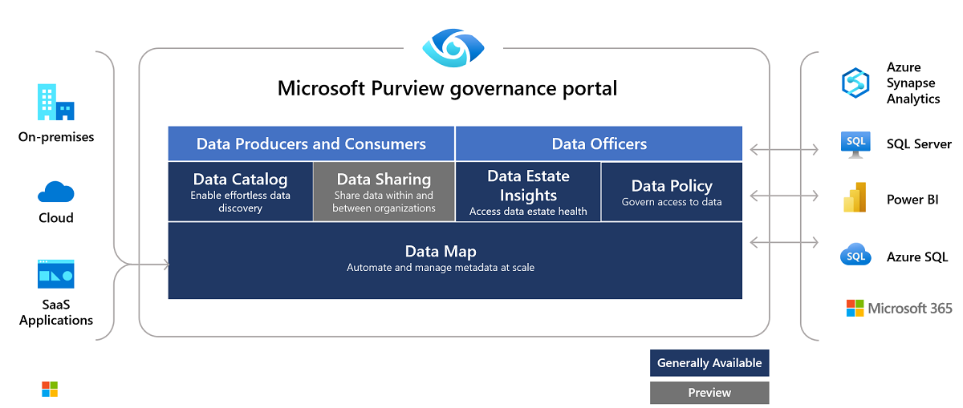
https://learn.microsoft.com/en-us/purview/governance-solutions-overview
Notes:
Platform based approach and it uses the open source apache atlas which is an open API system where customers can also work on this to add more datasources that they do not yet support.

Slide 10
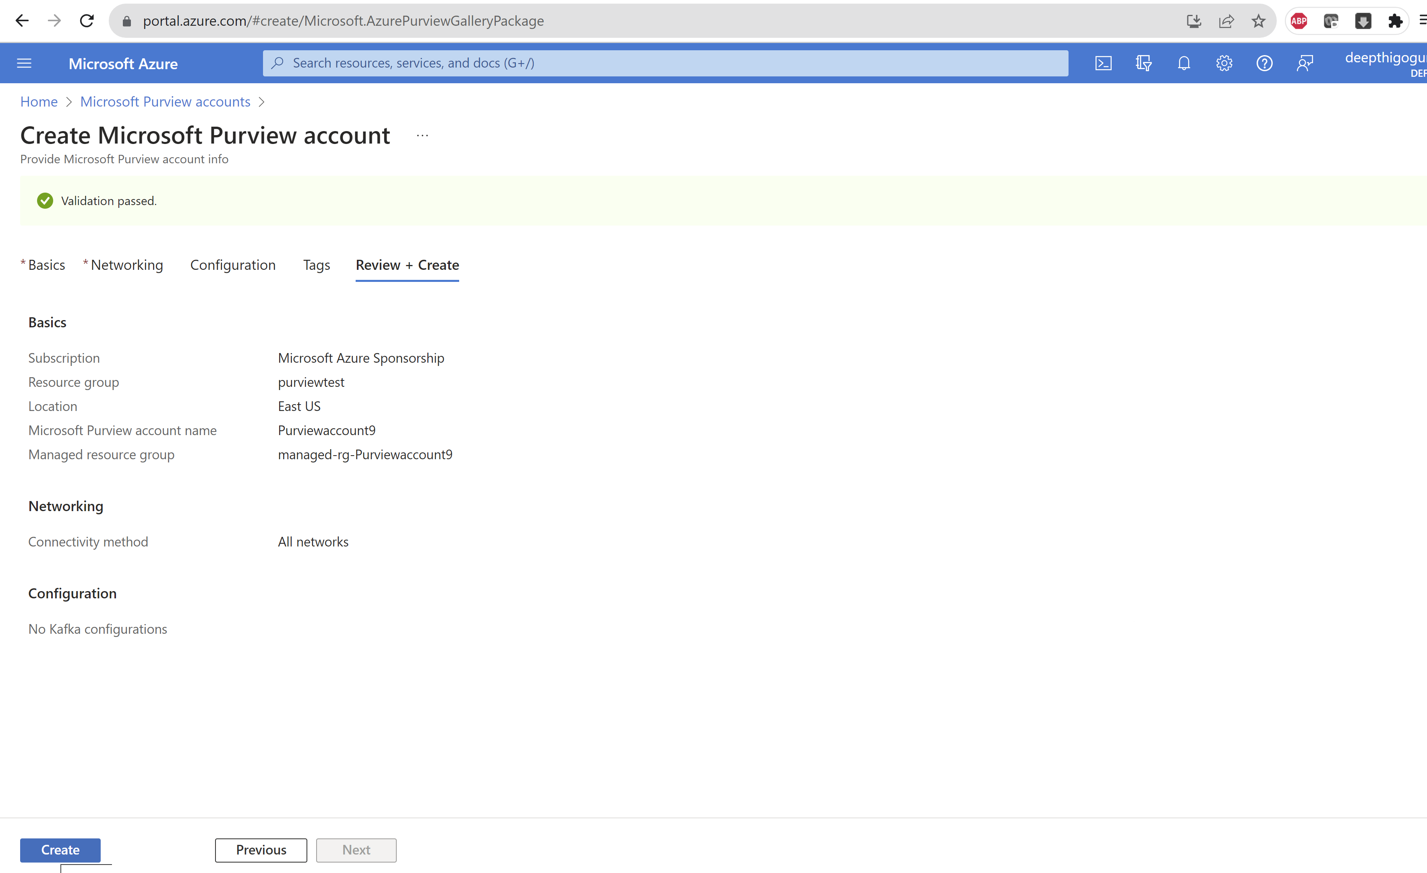
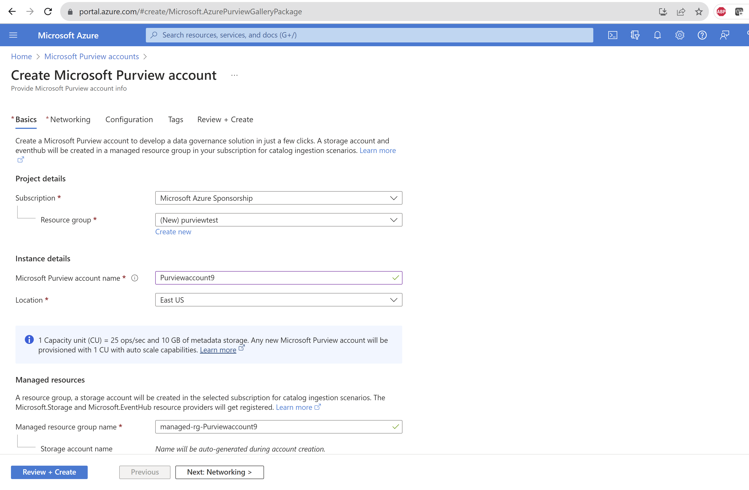

Slide 11
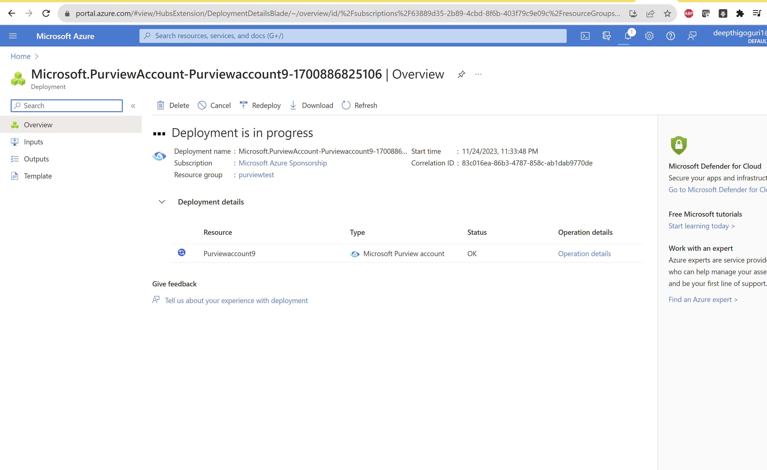

Slide 12
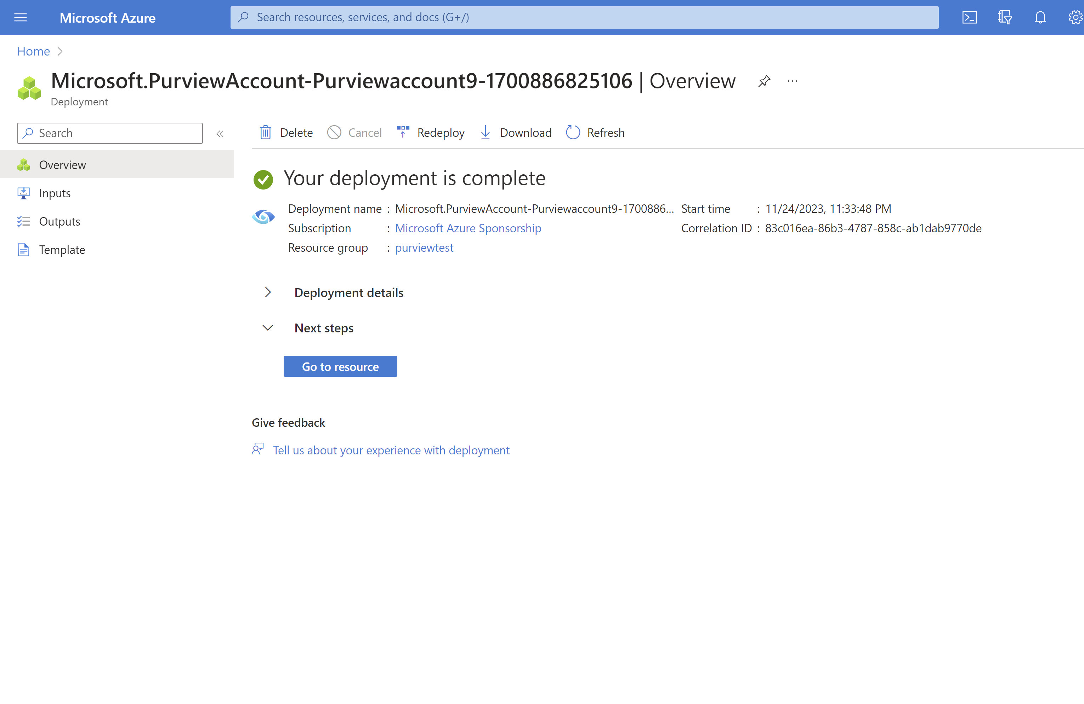

Slide 13
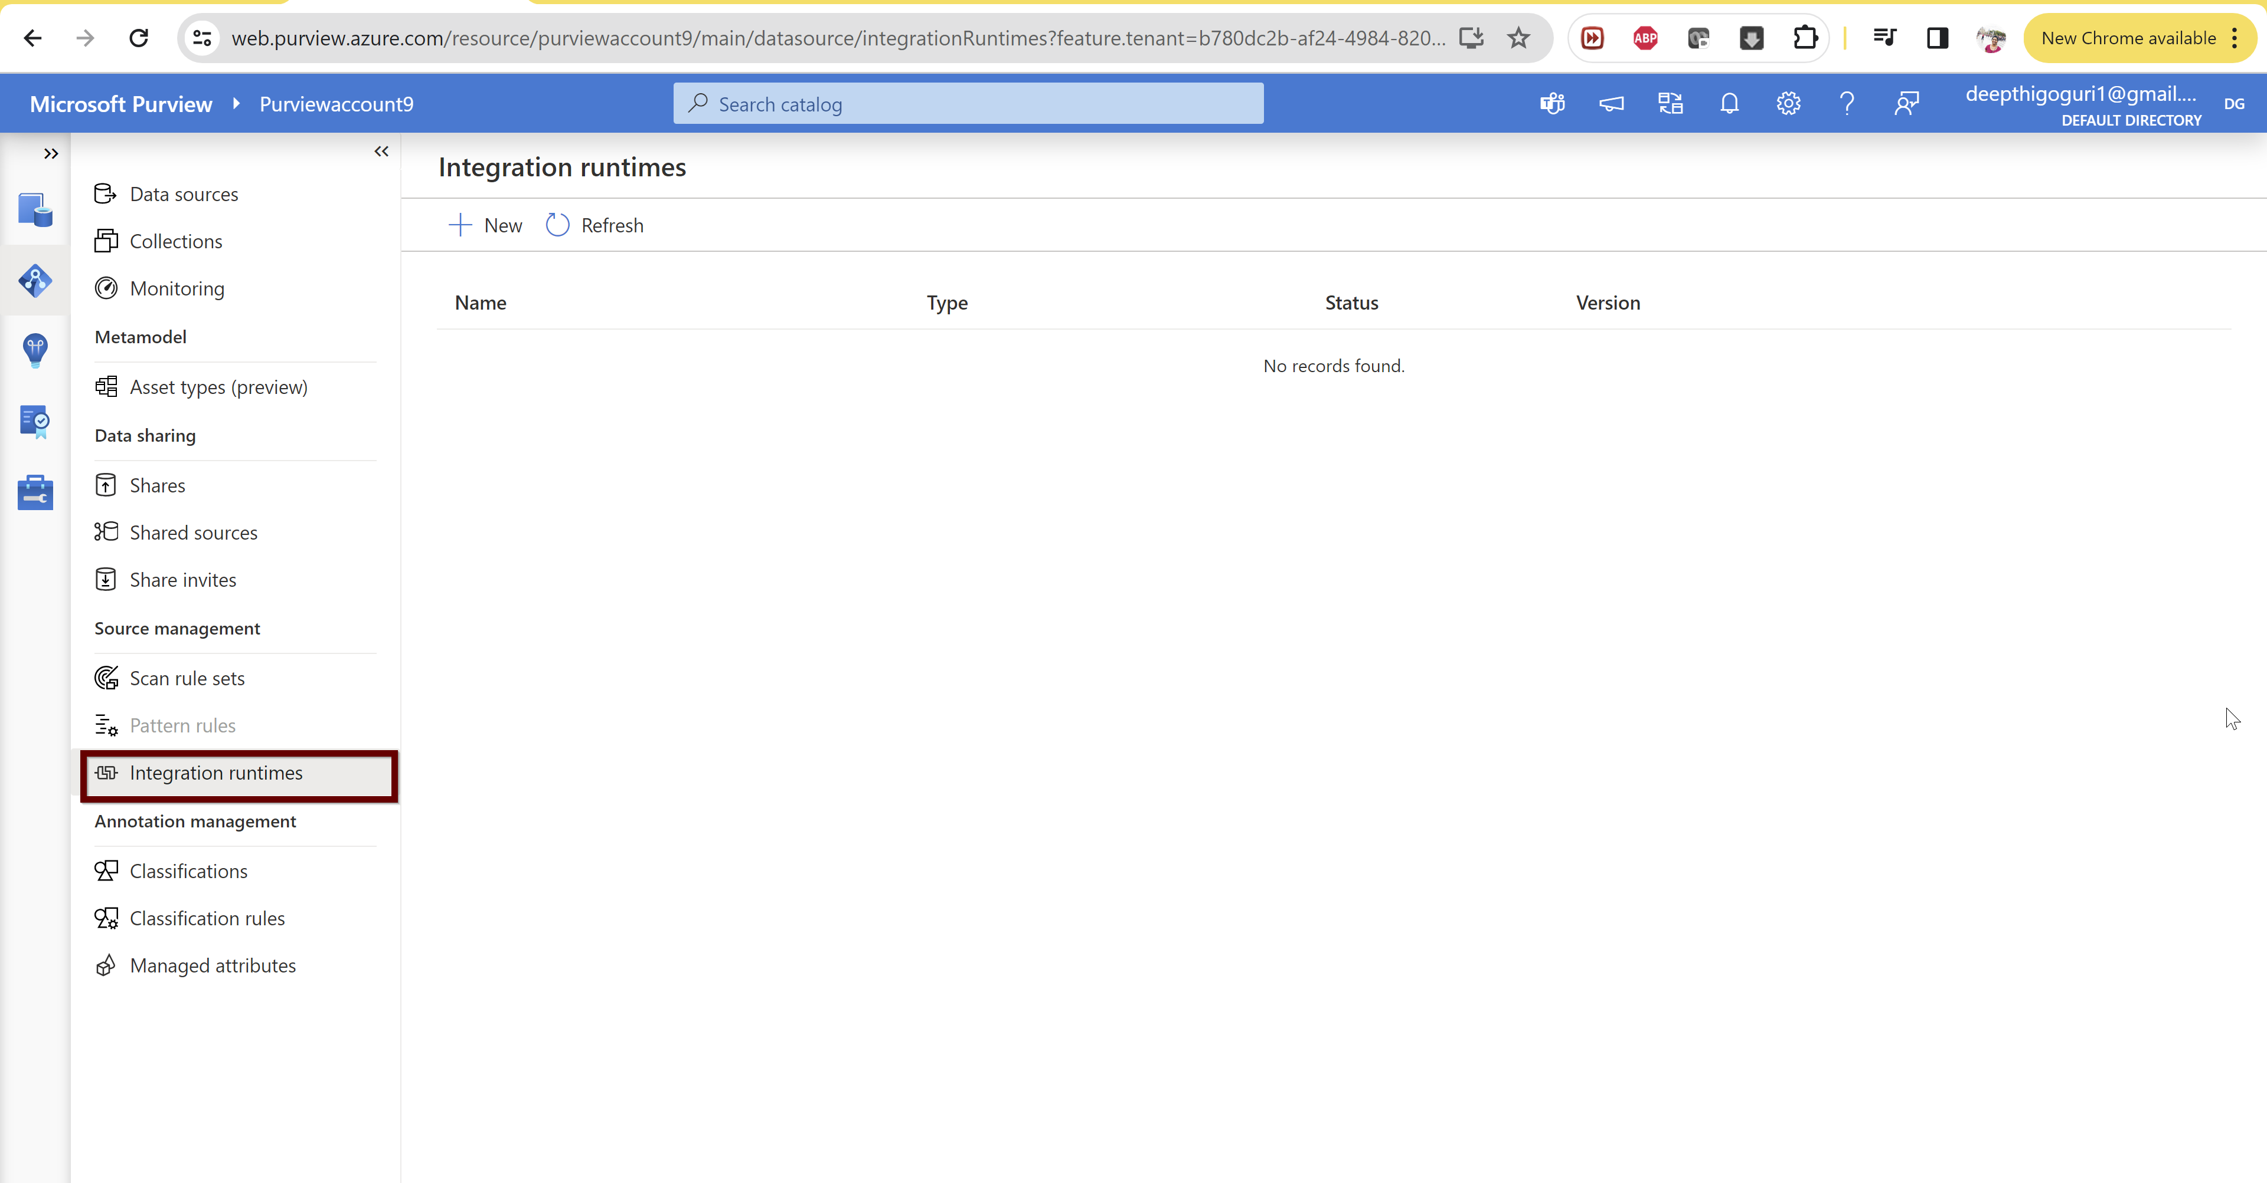

Slide 14
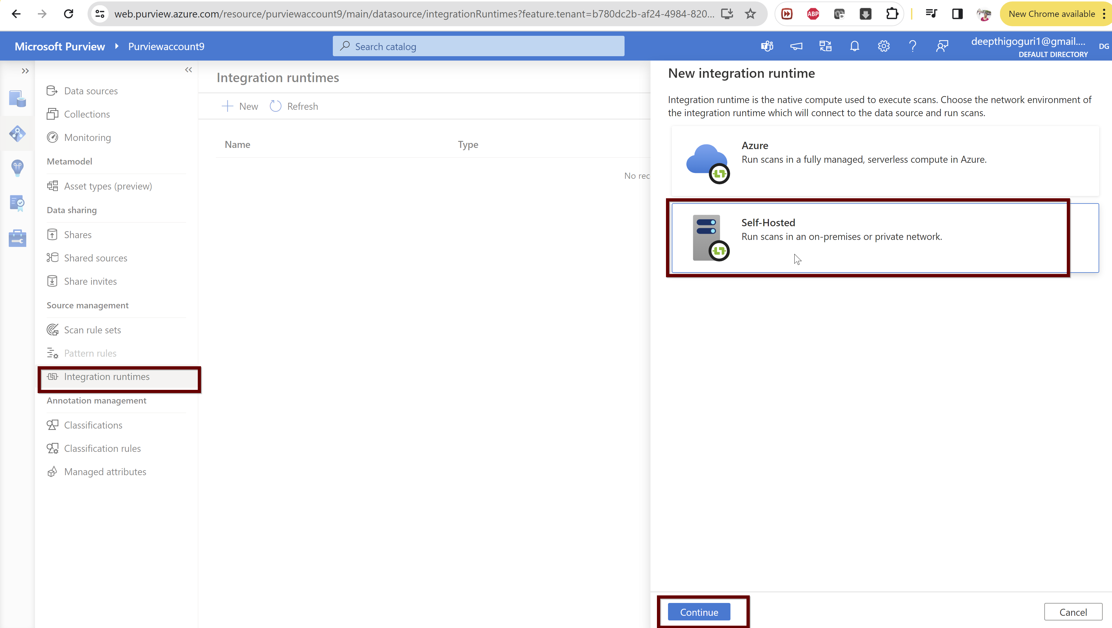

Slide 15
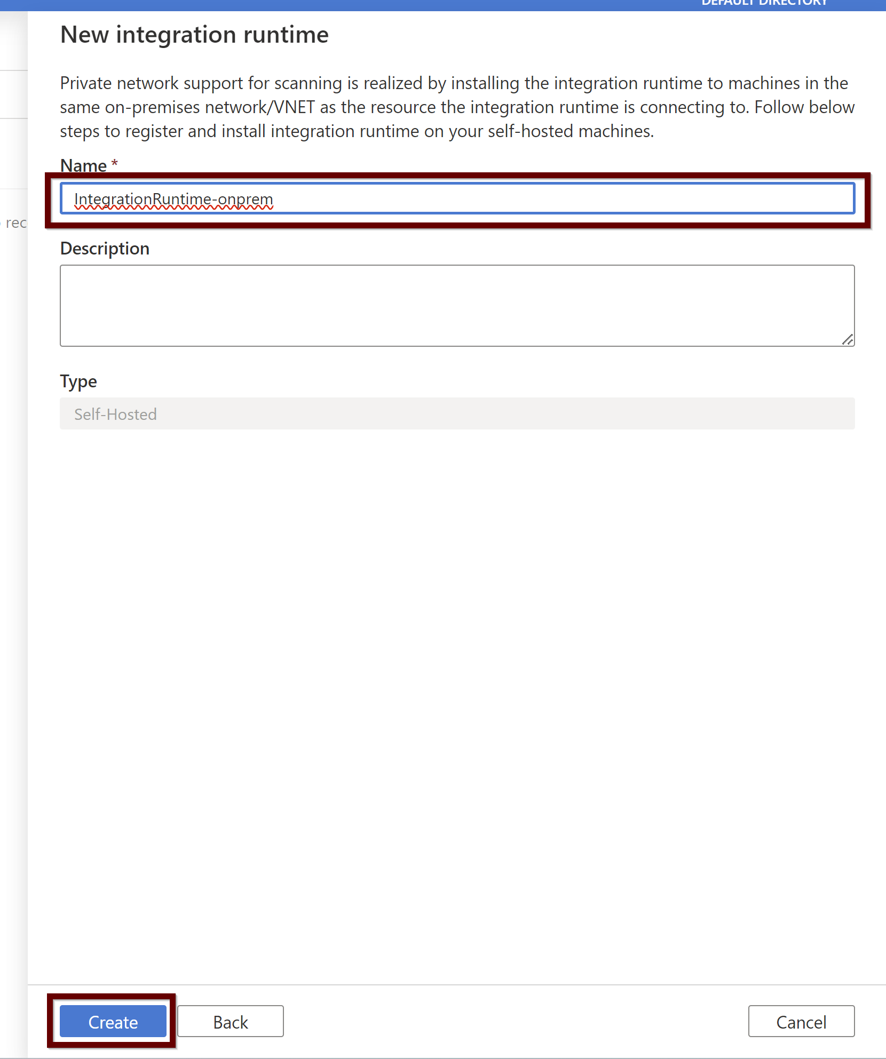

Slide 16
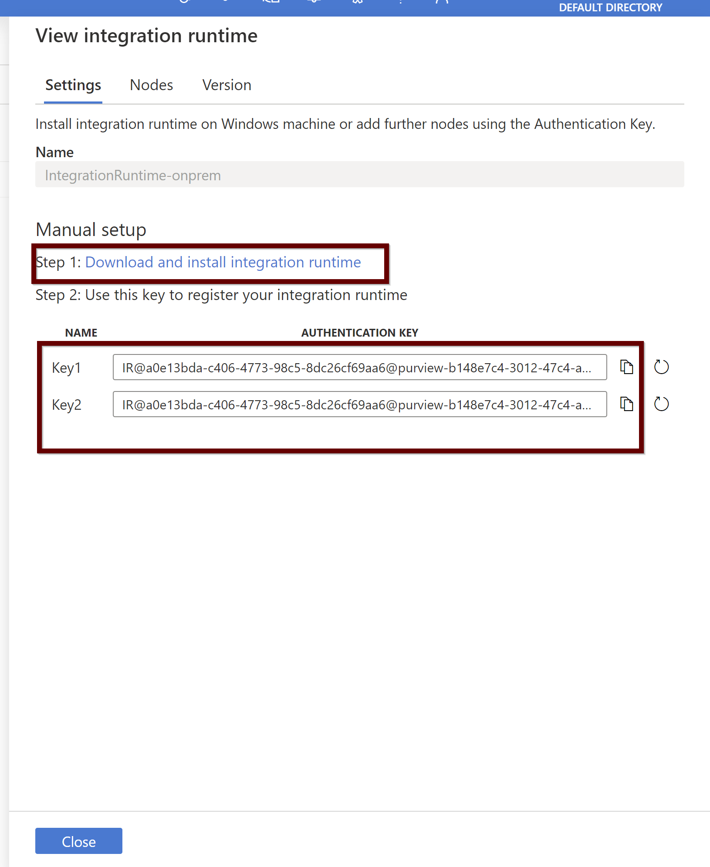

Slide 17
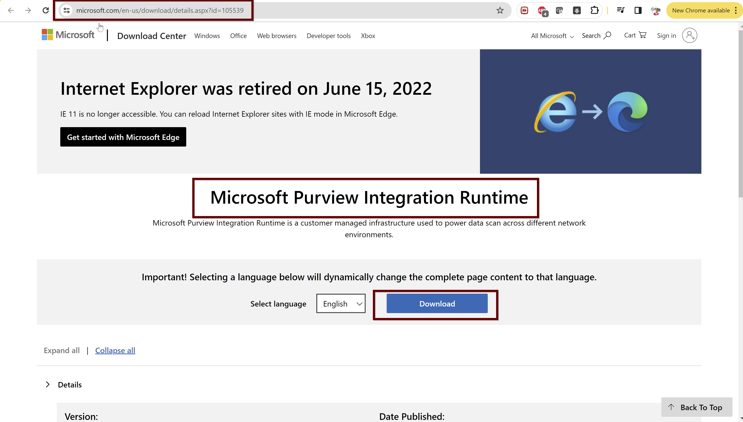

Slide 18
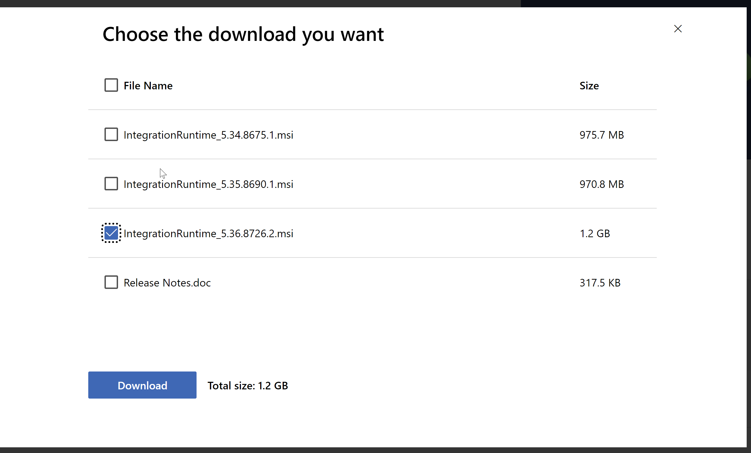

Slide 19
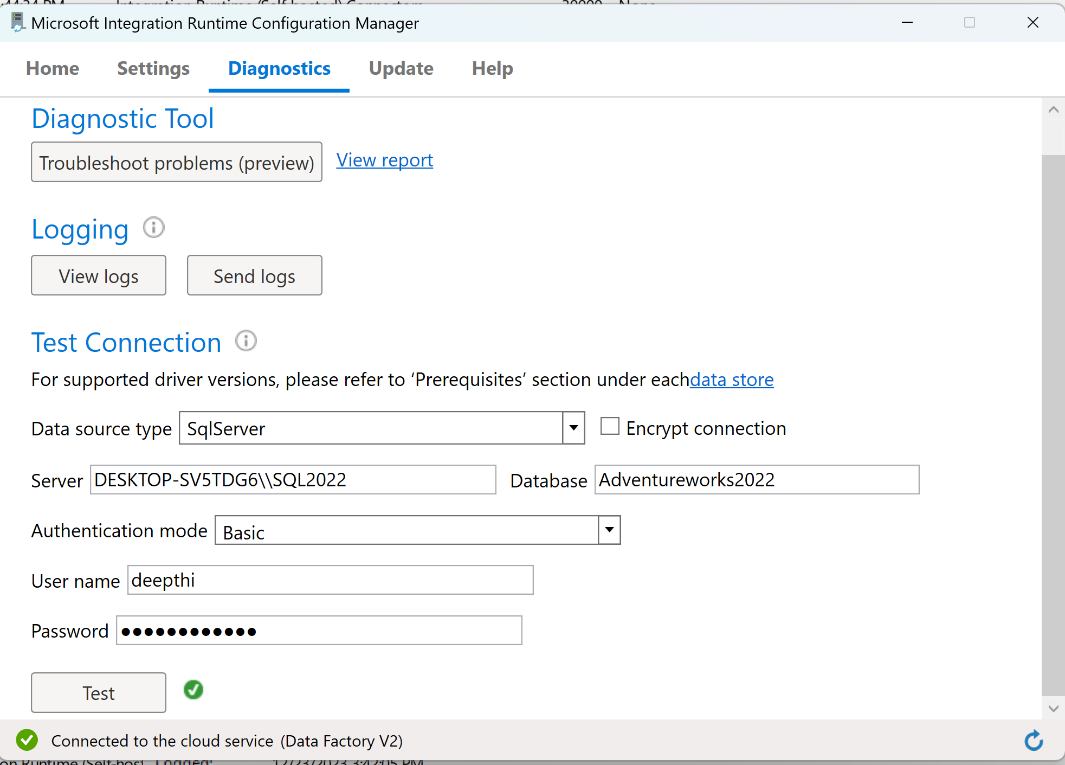

Slide 20
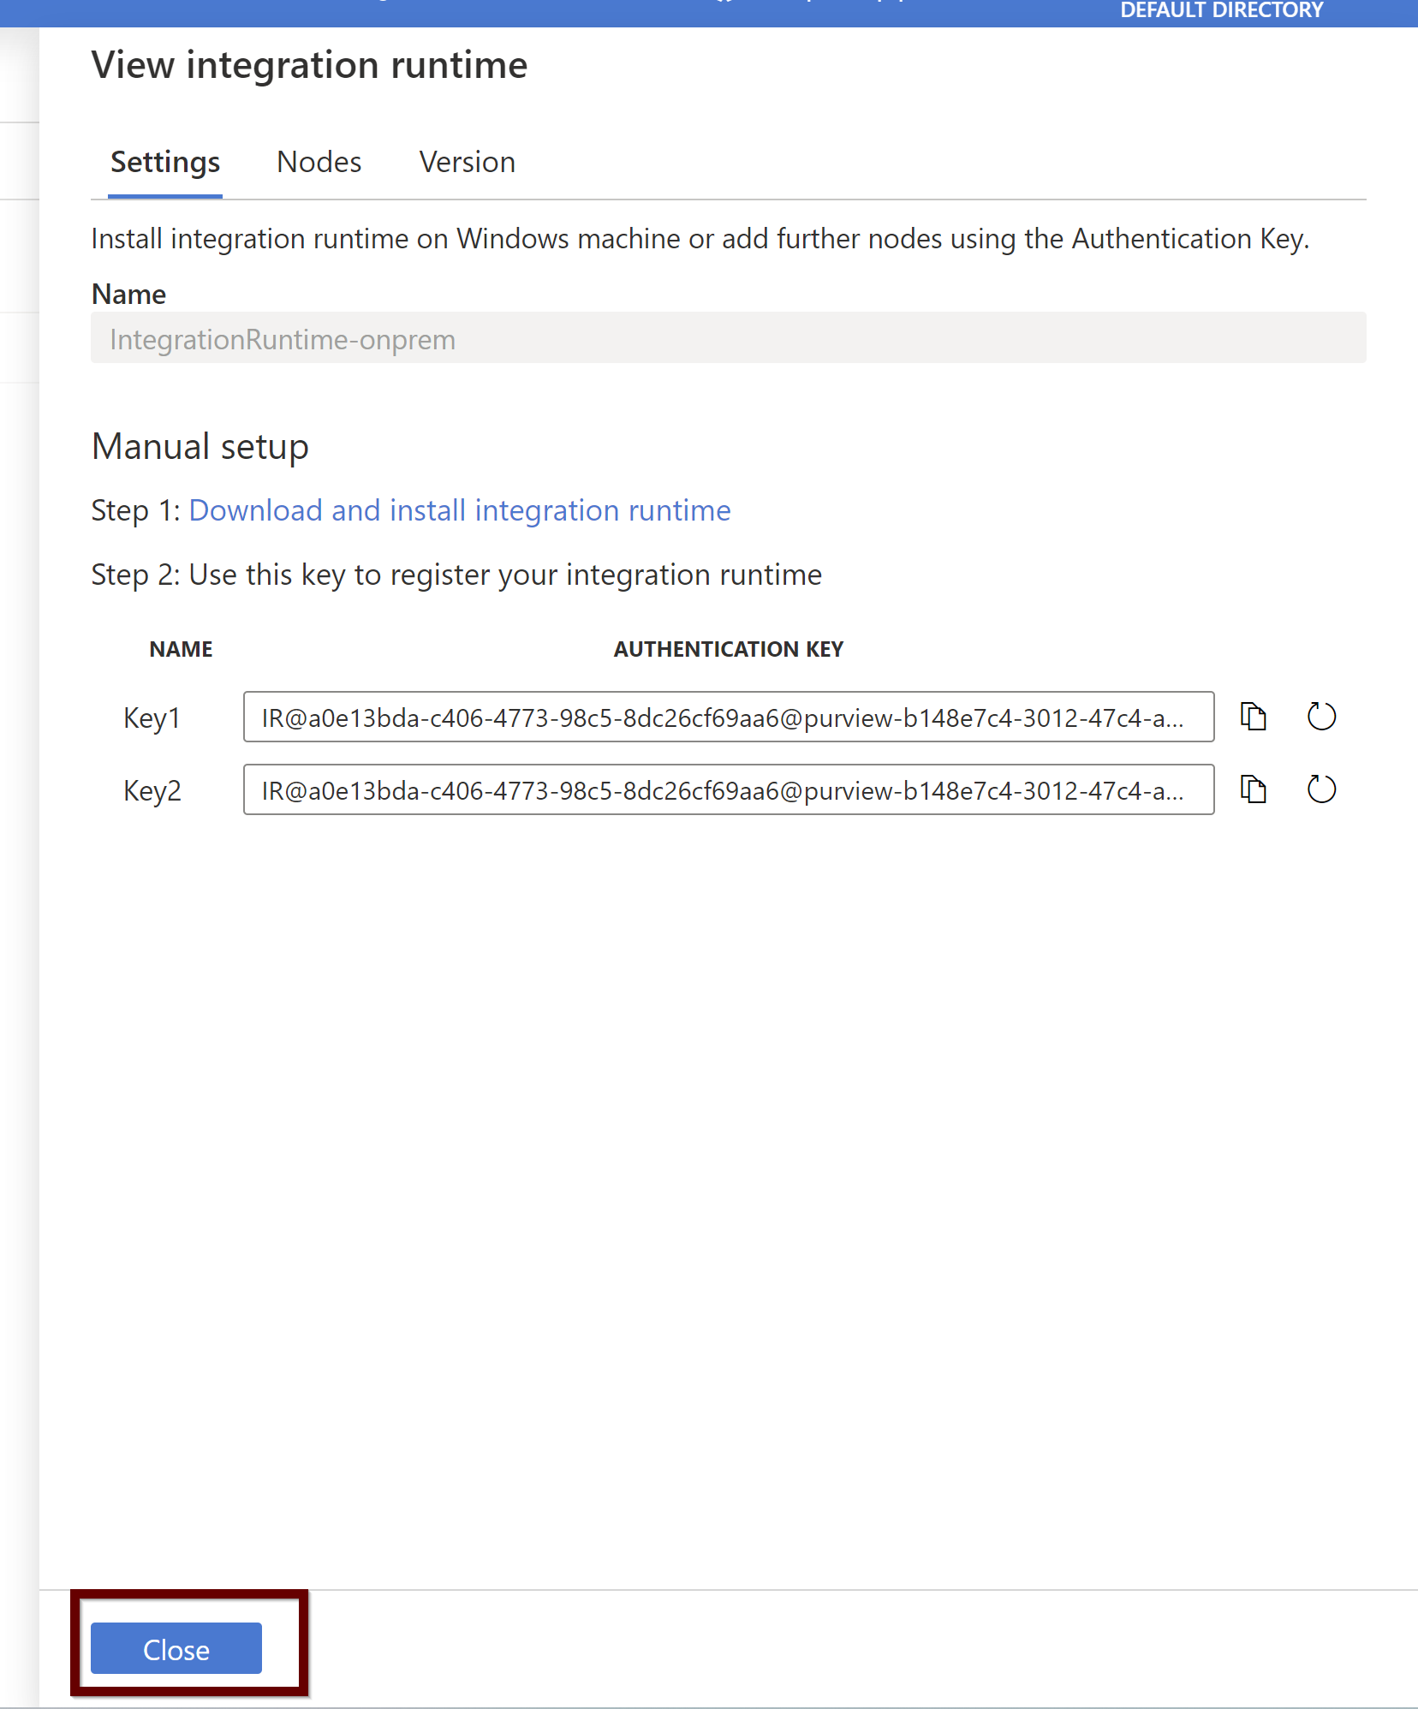

Slide 21
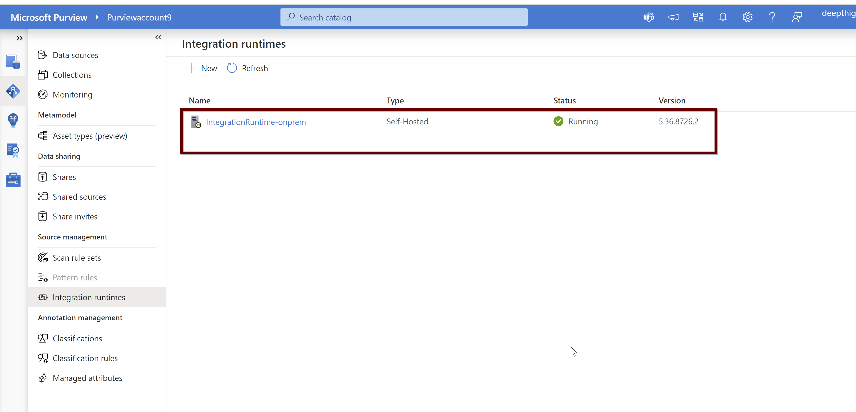

Slide 22
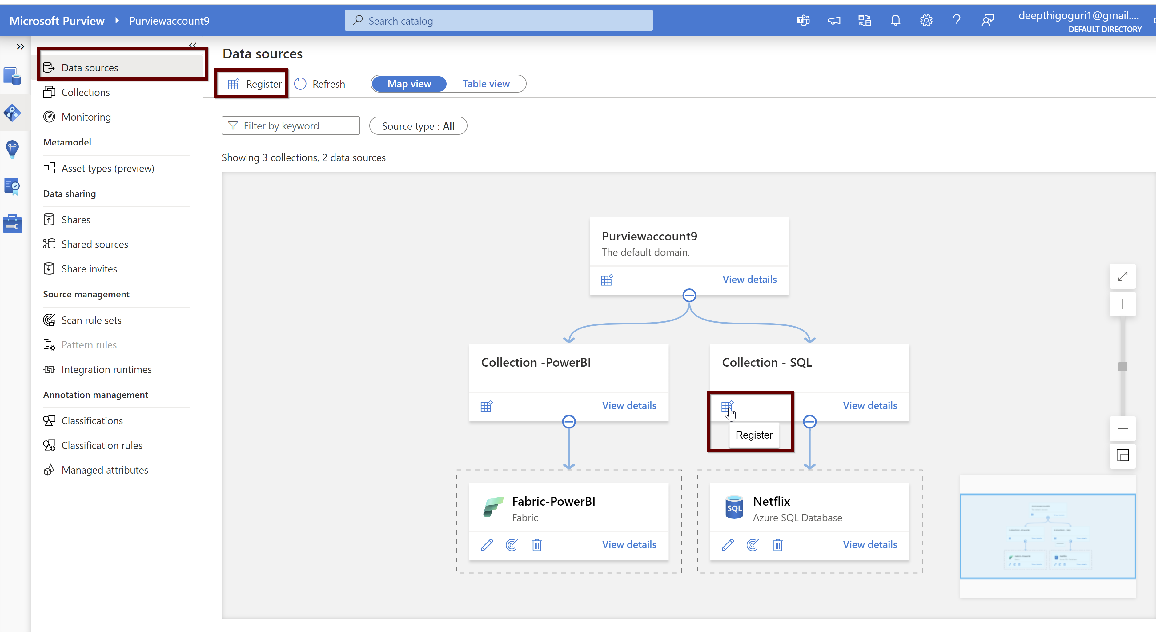

Slide 23
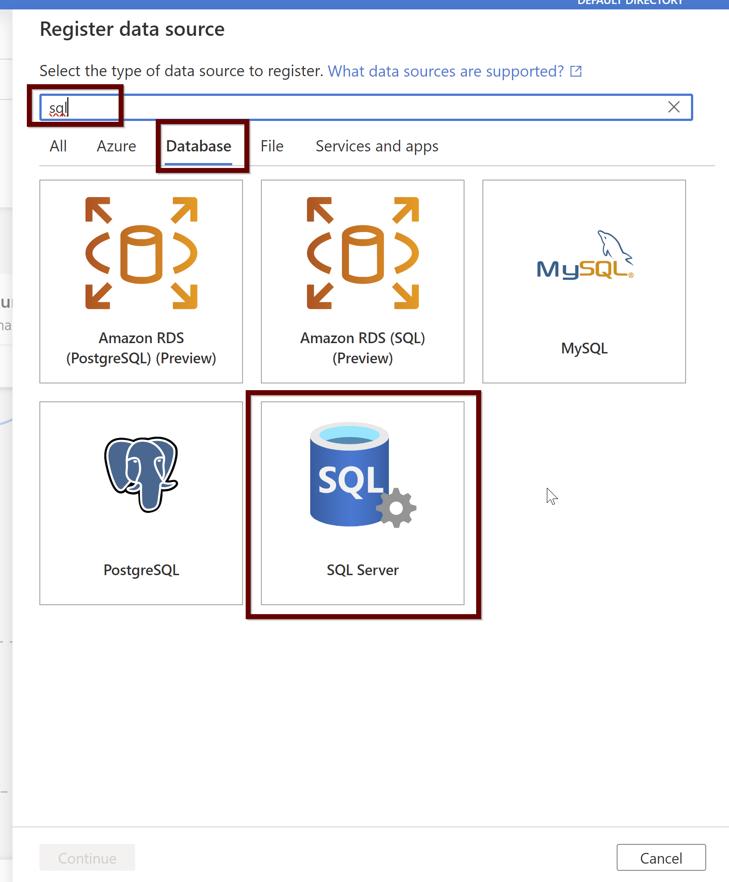

Slide 24
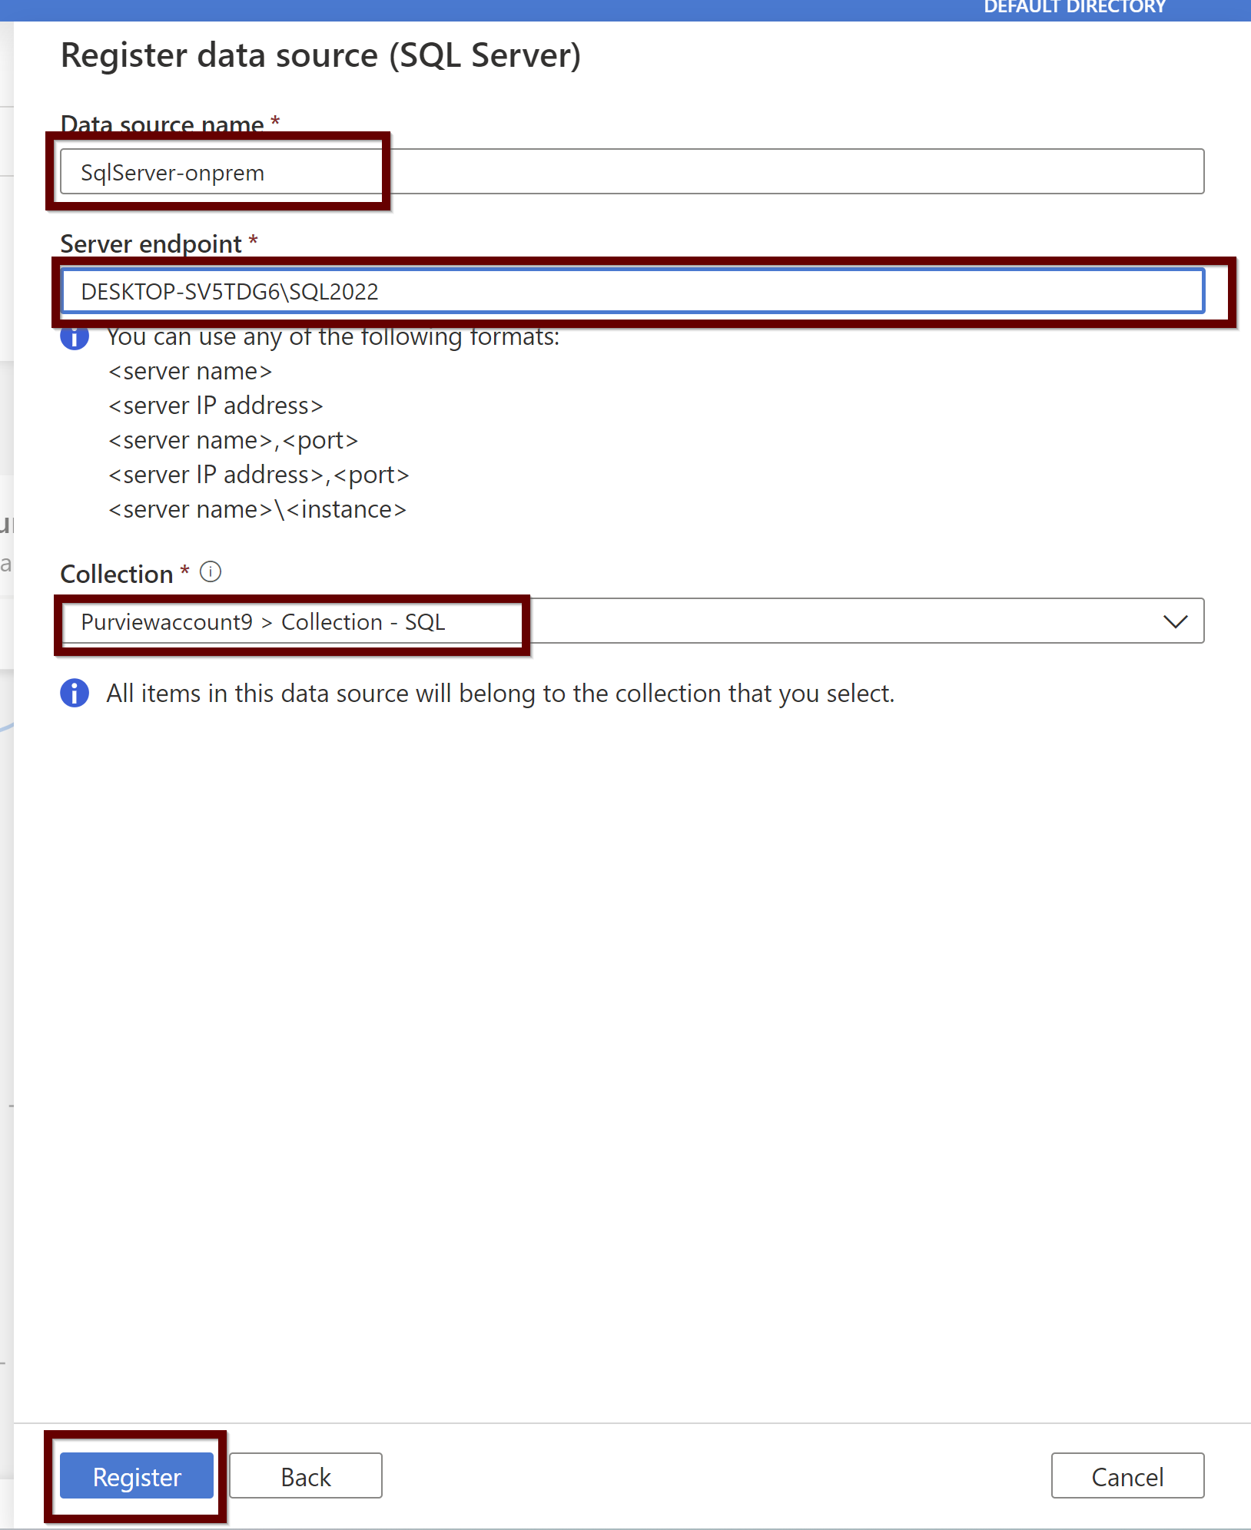

Slide 25
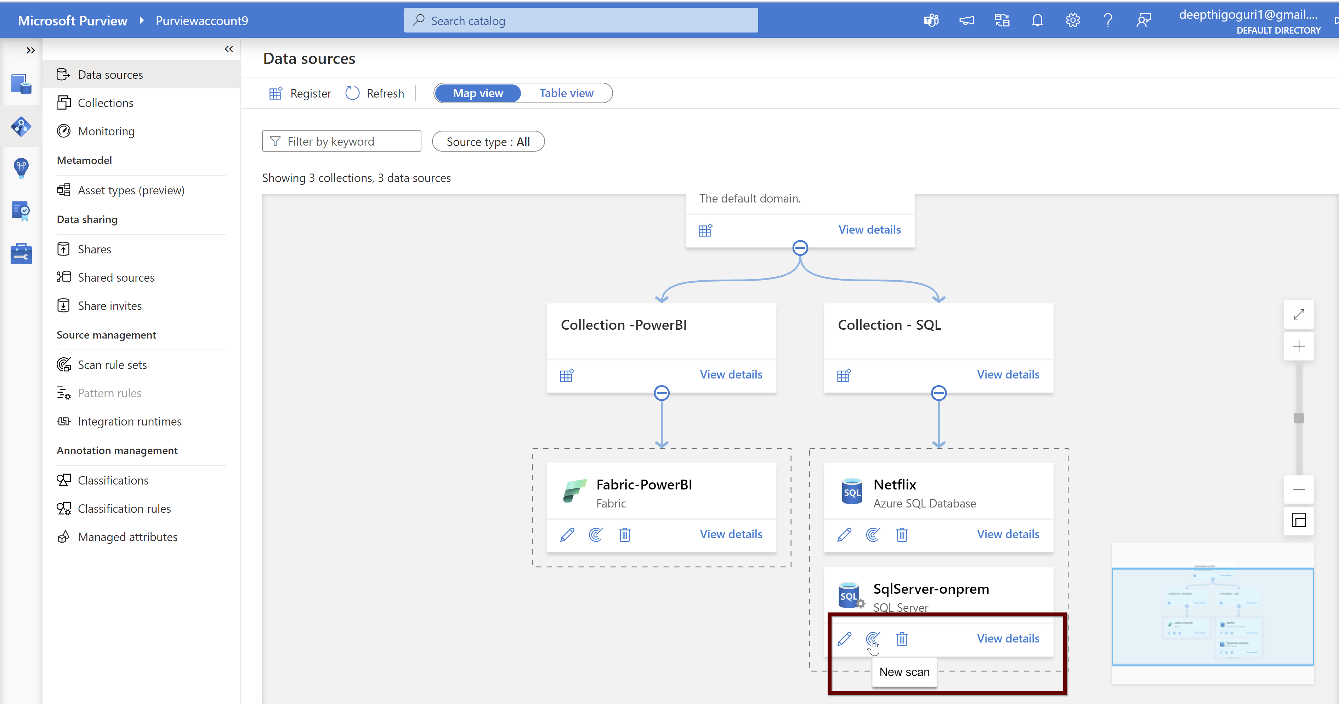

Slide 26
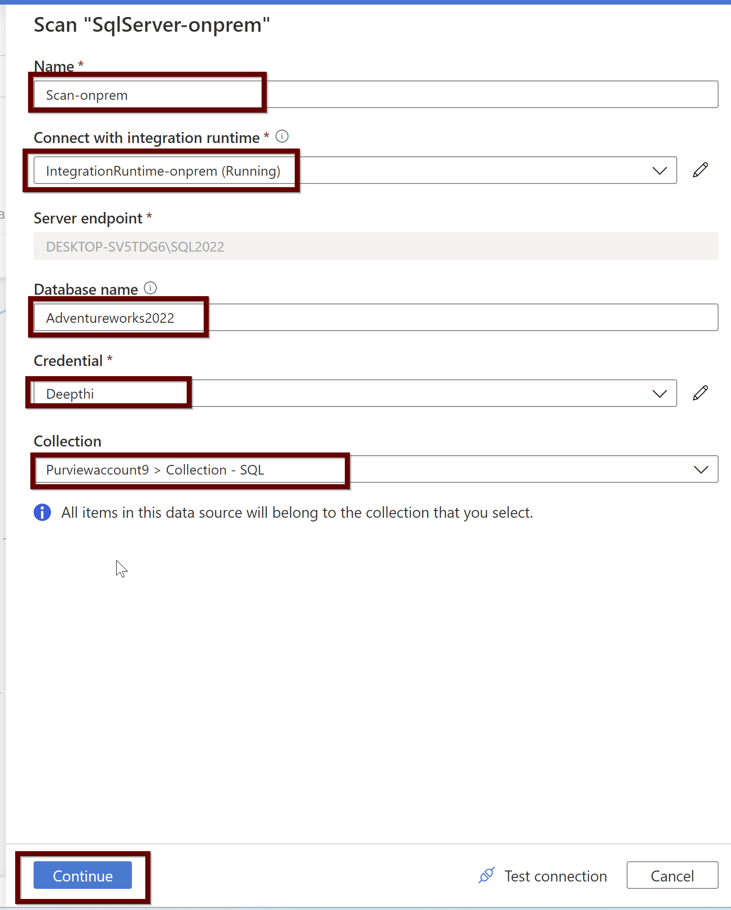

Slide 27
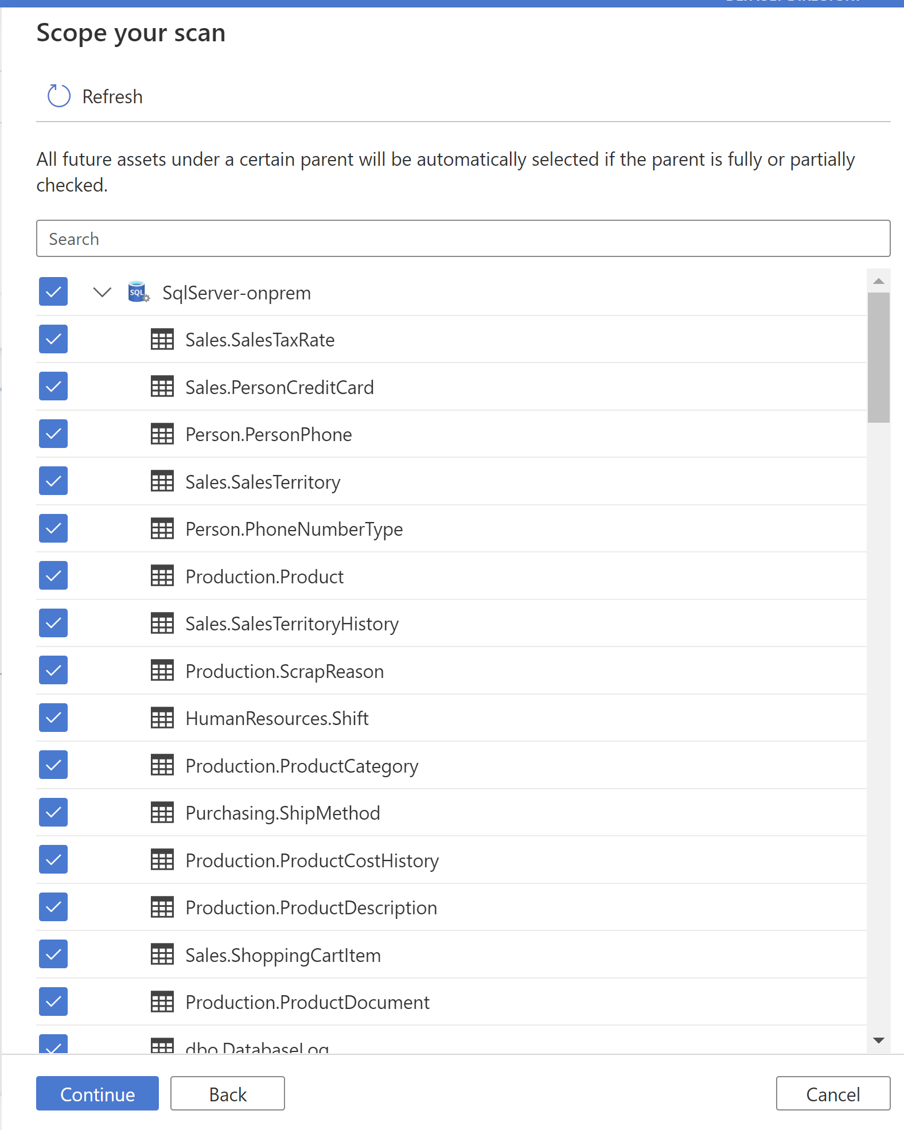

Slide 28
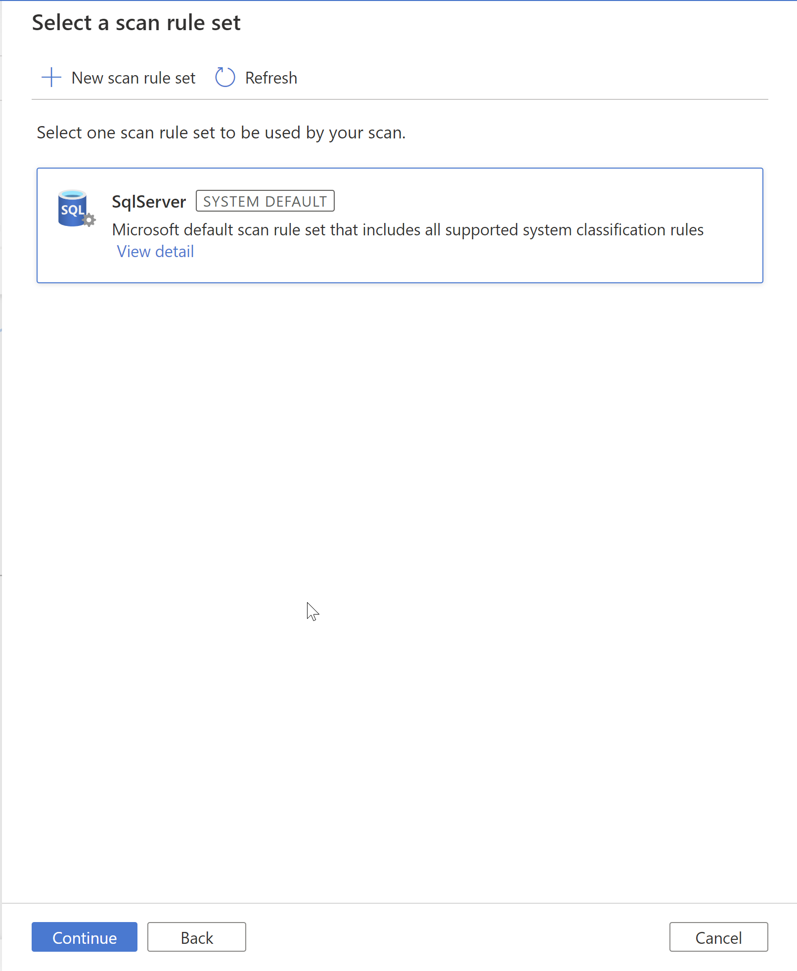

Slide 29
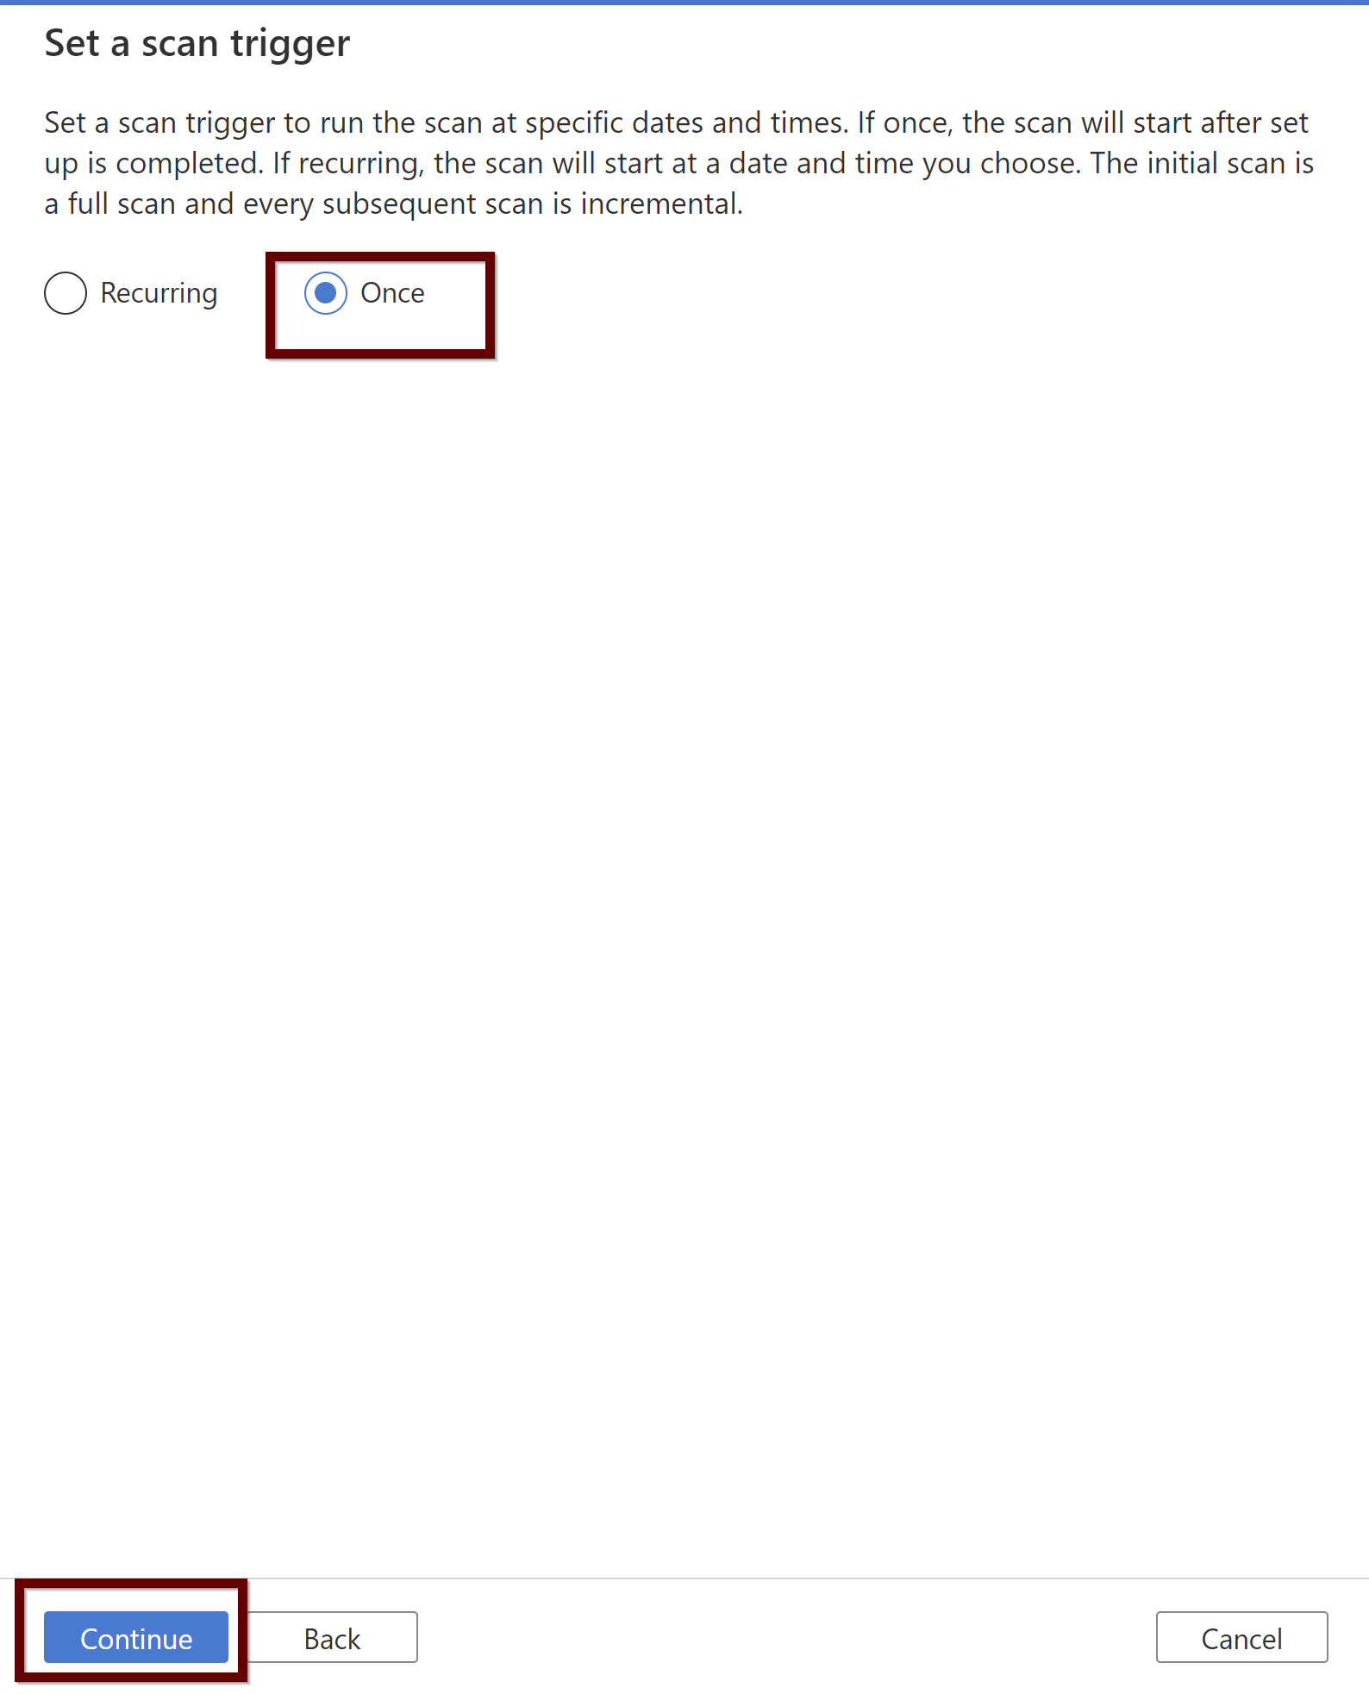

Slide 30
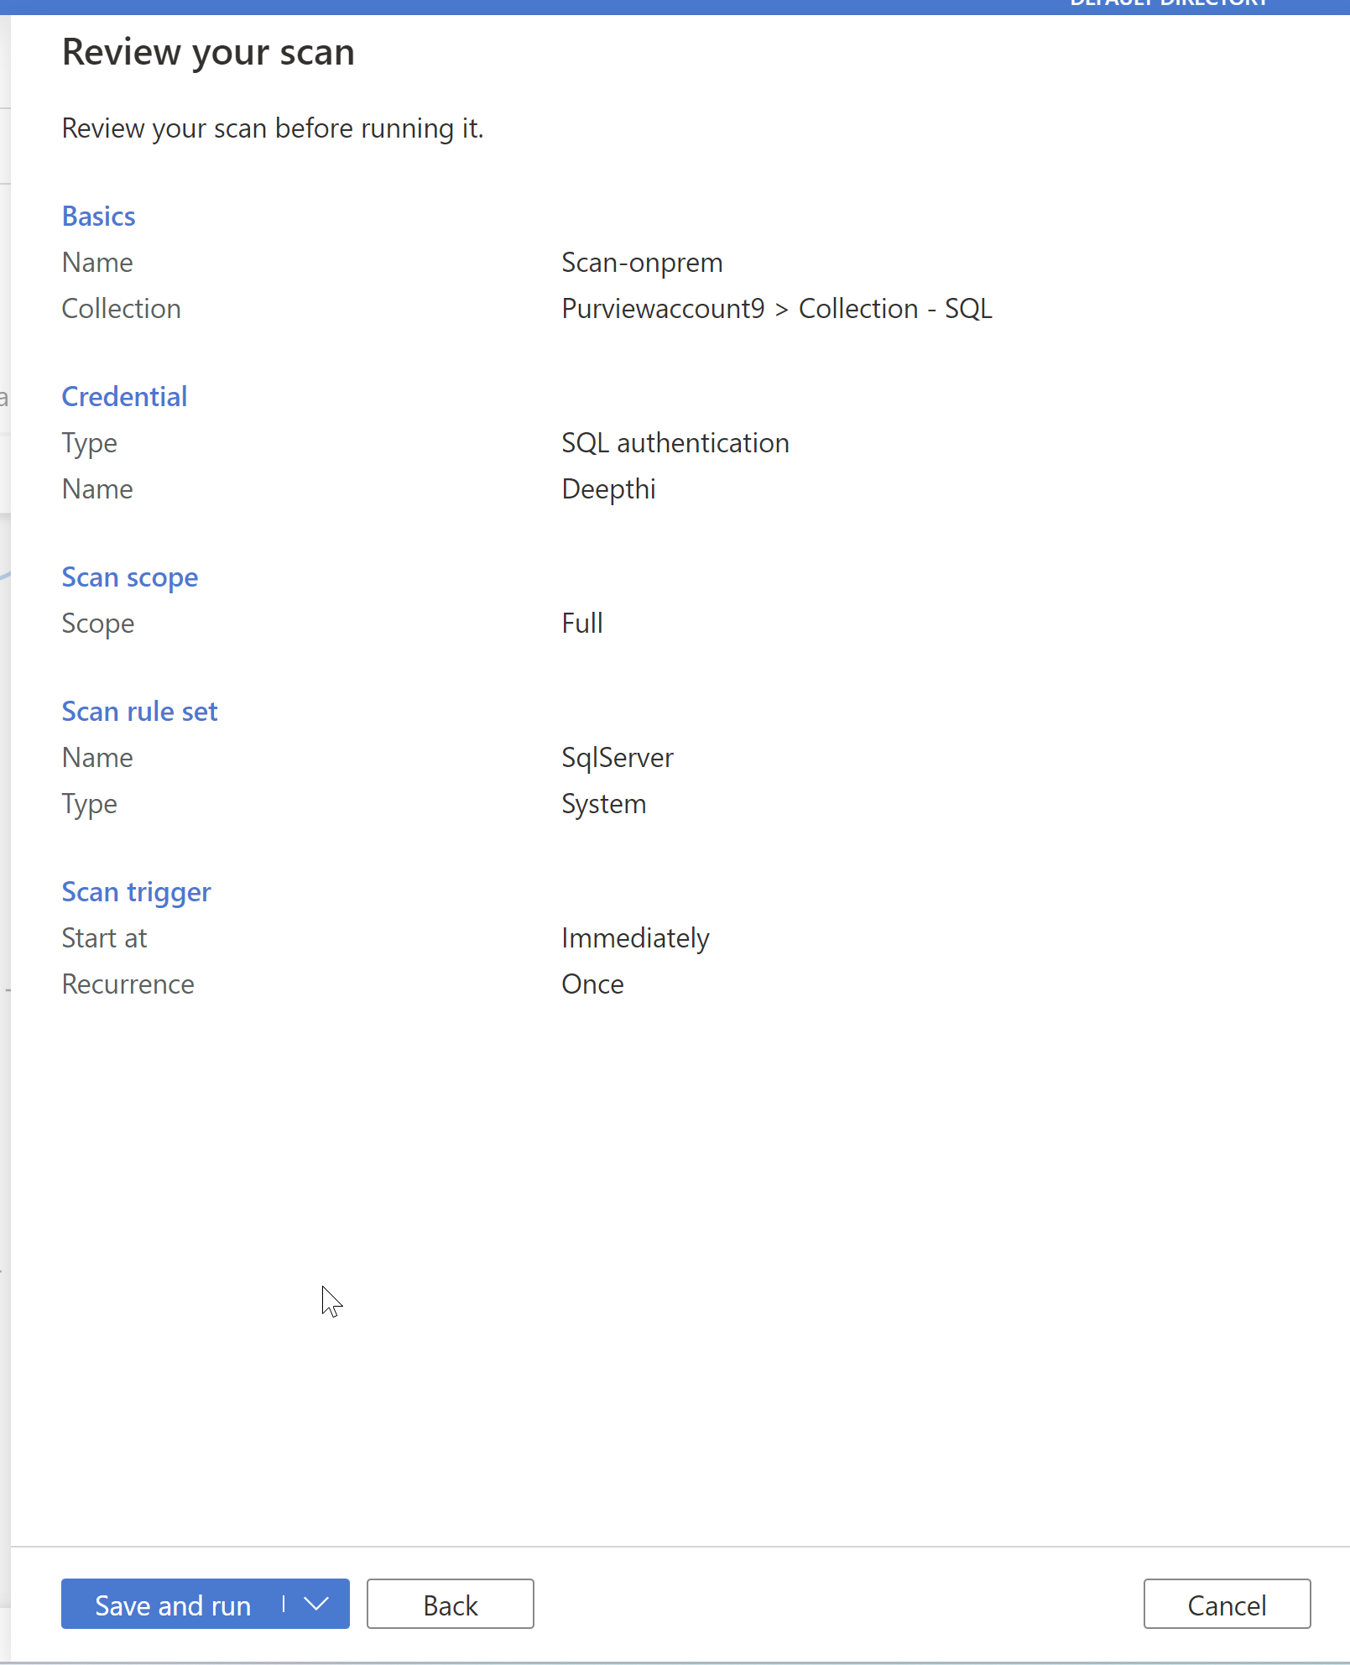

Slide 31
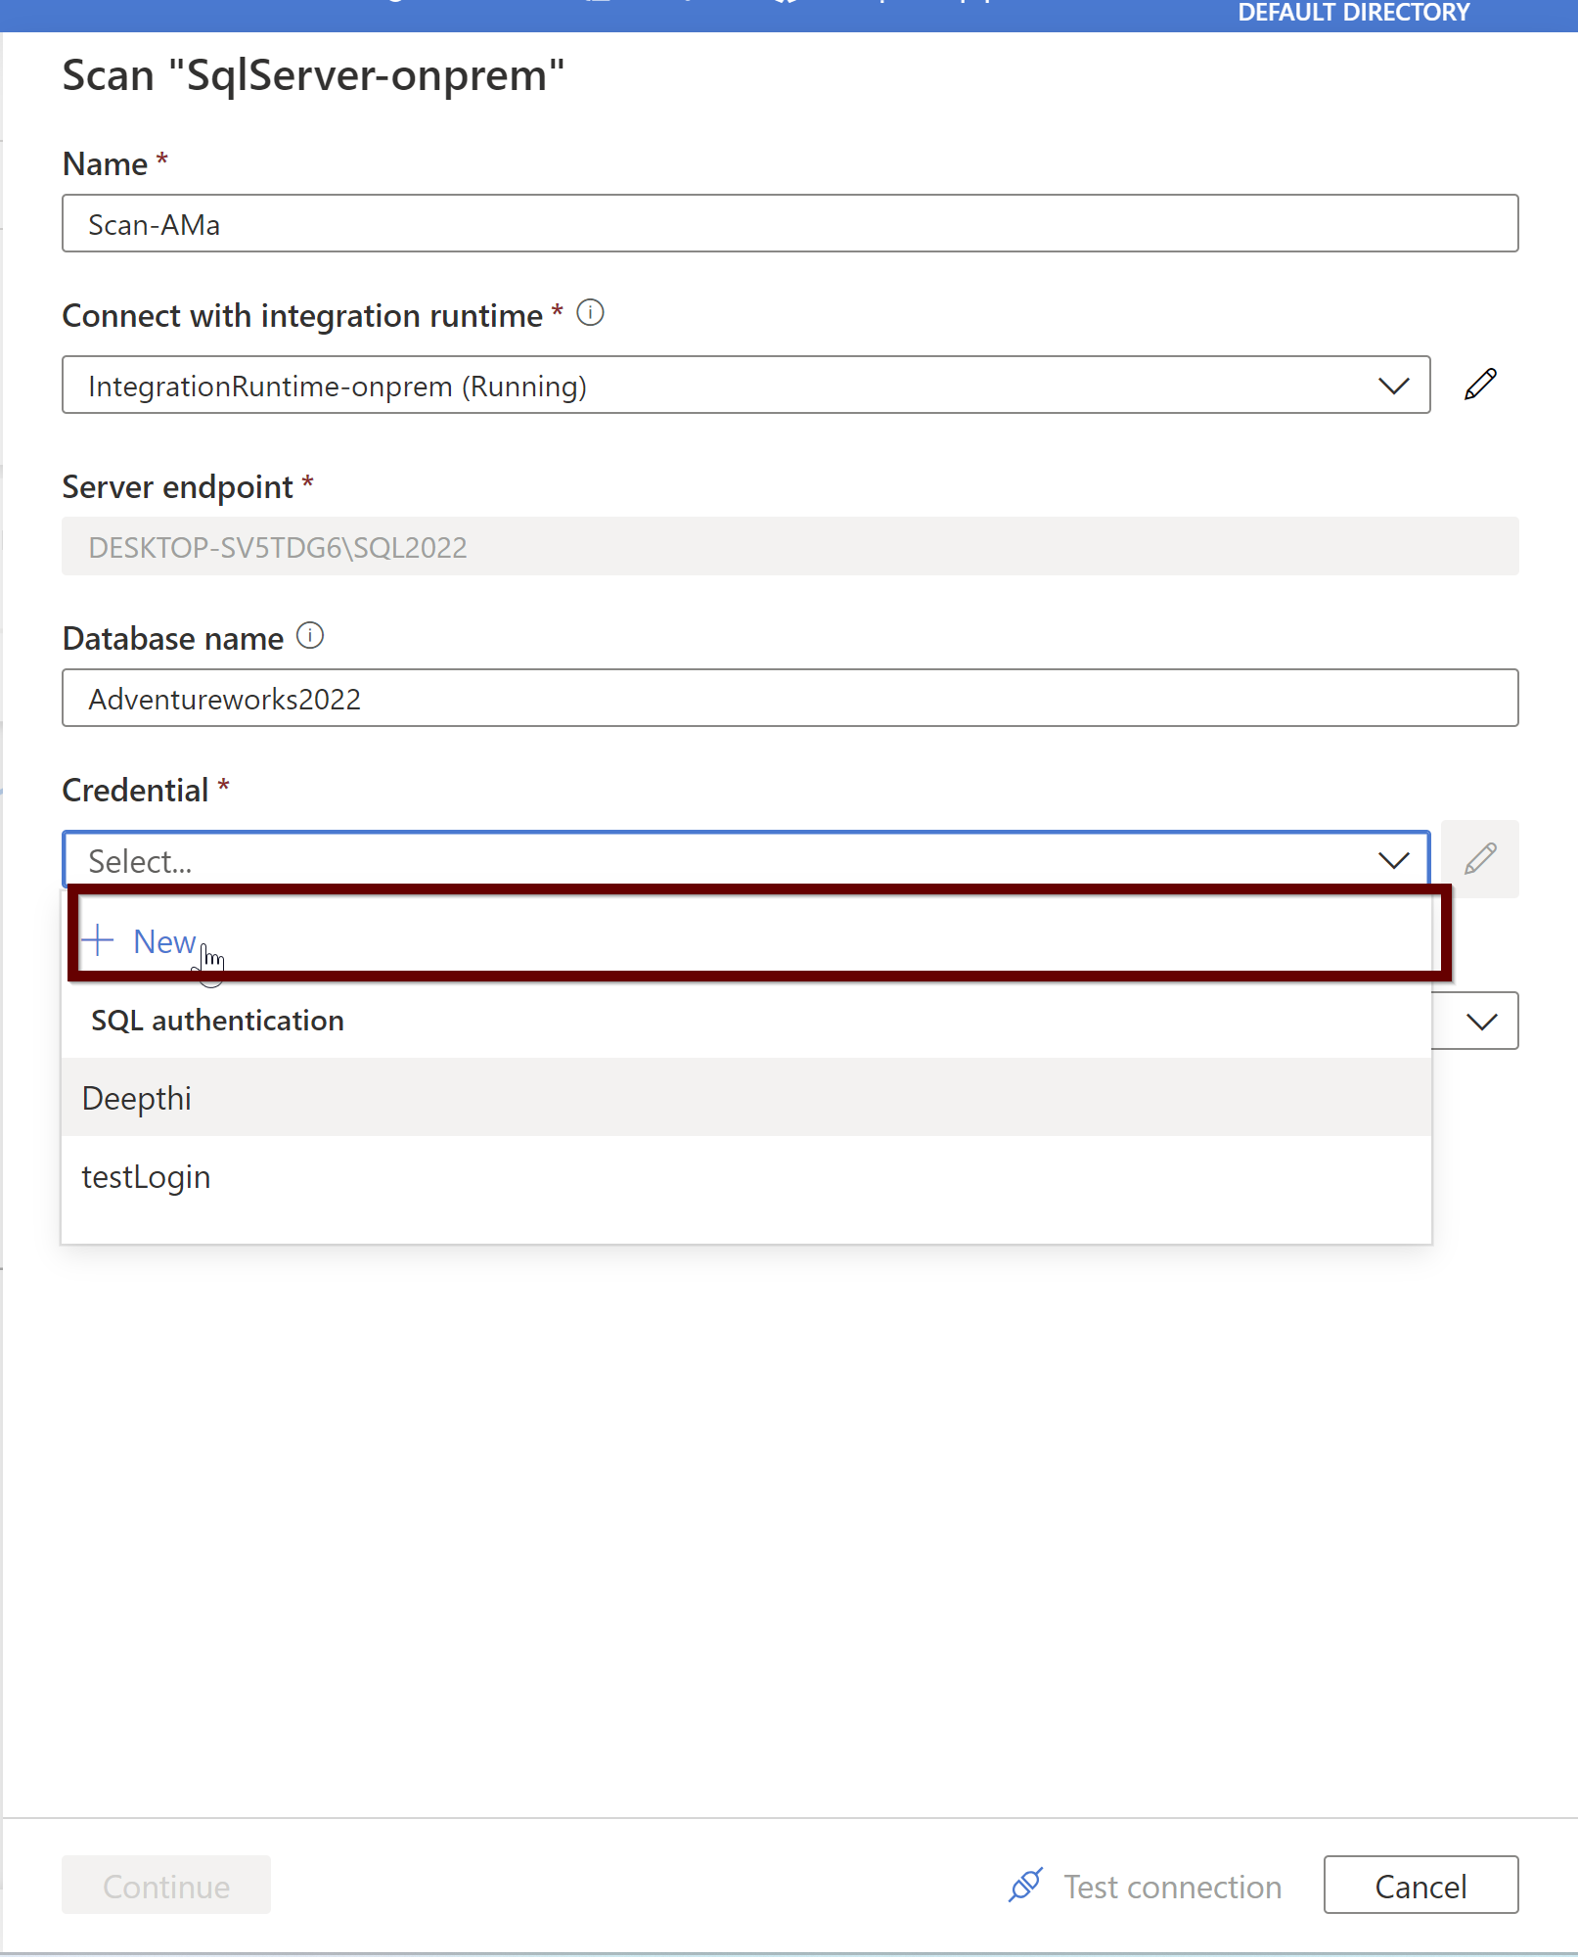

Slide 32
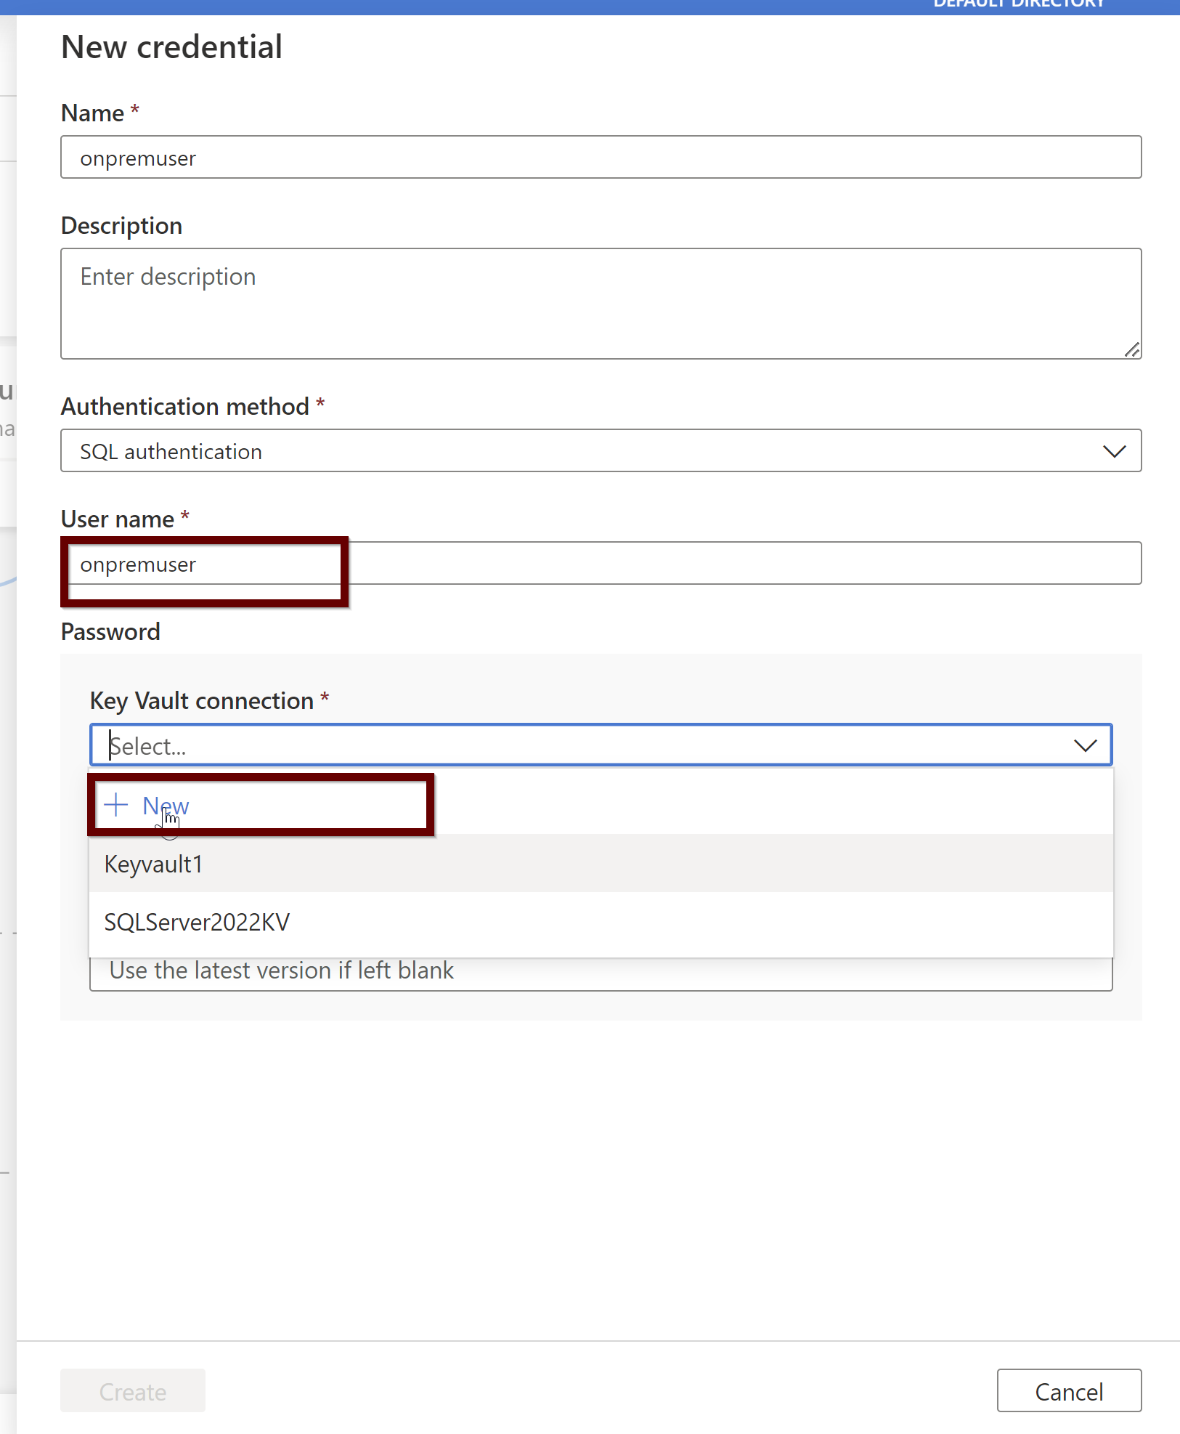

Slide 33
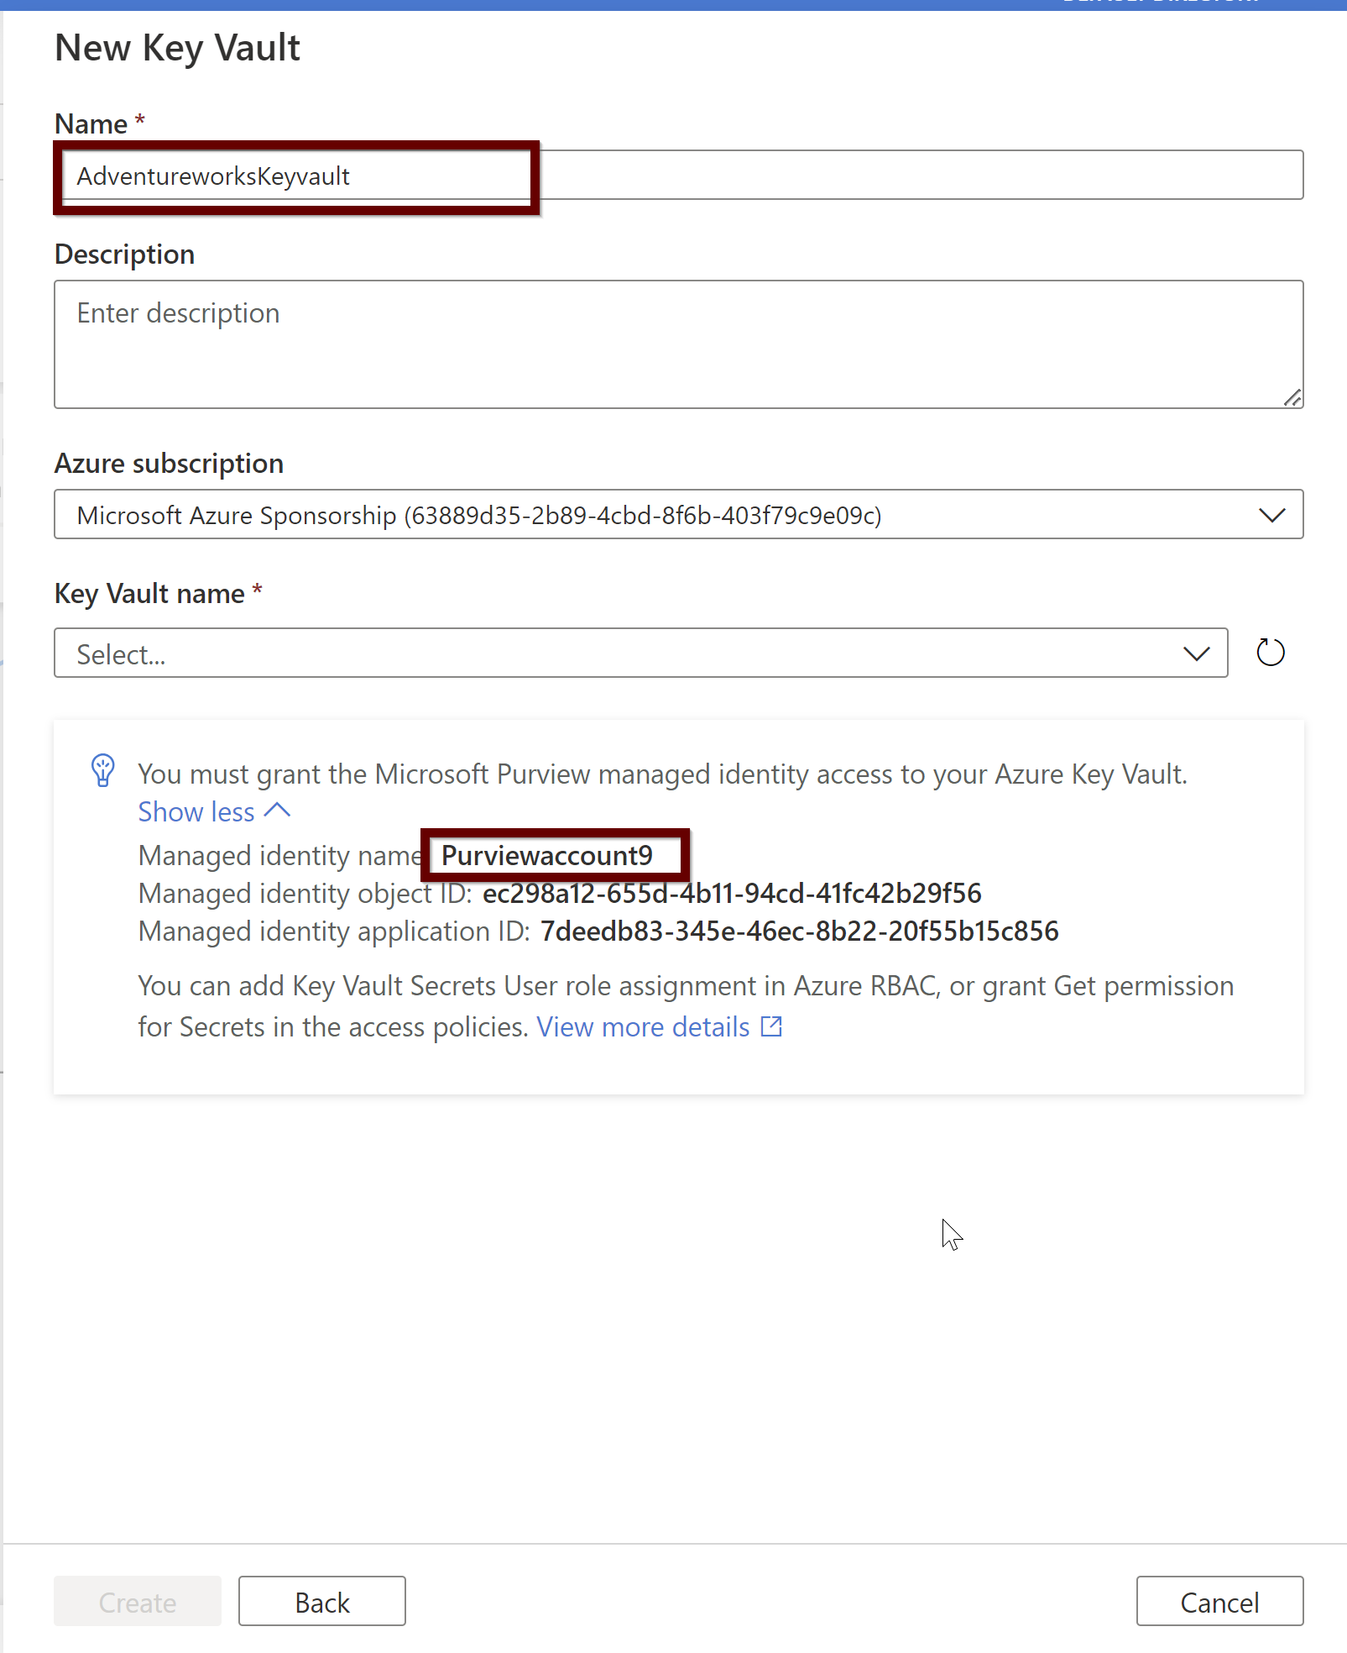

Slide 34
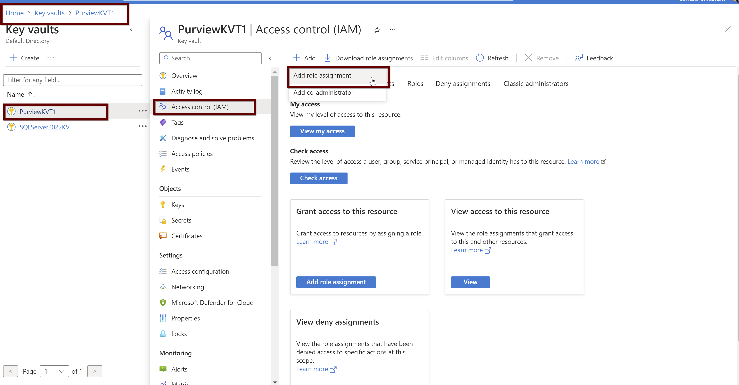

Slide 35
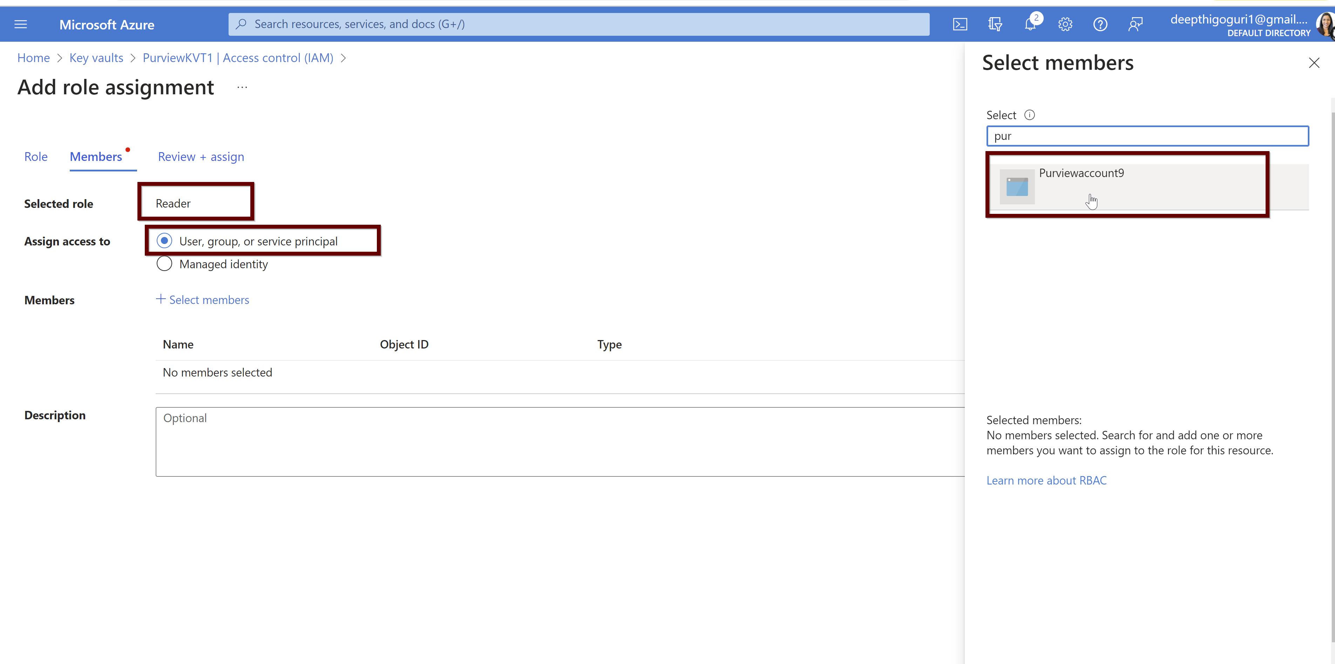

Slide 36
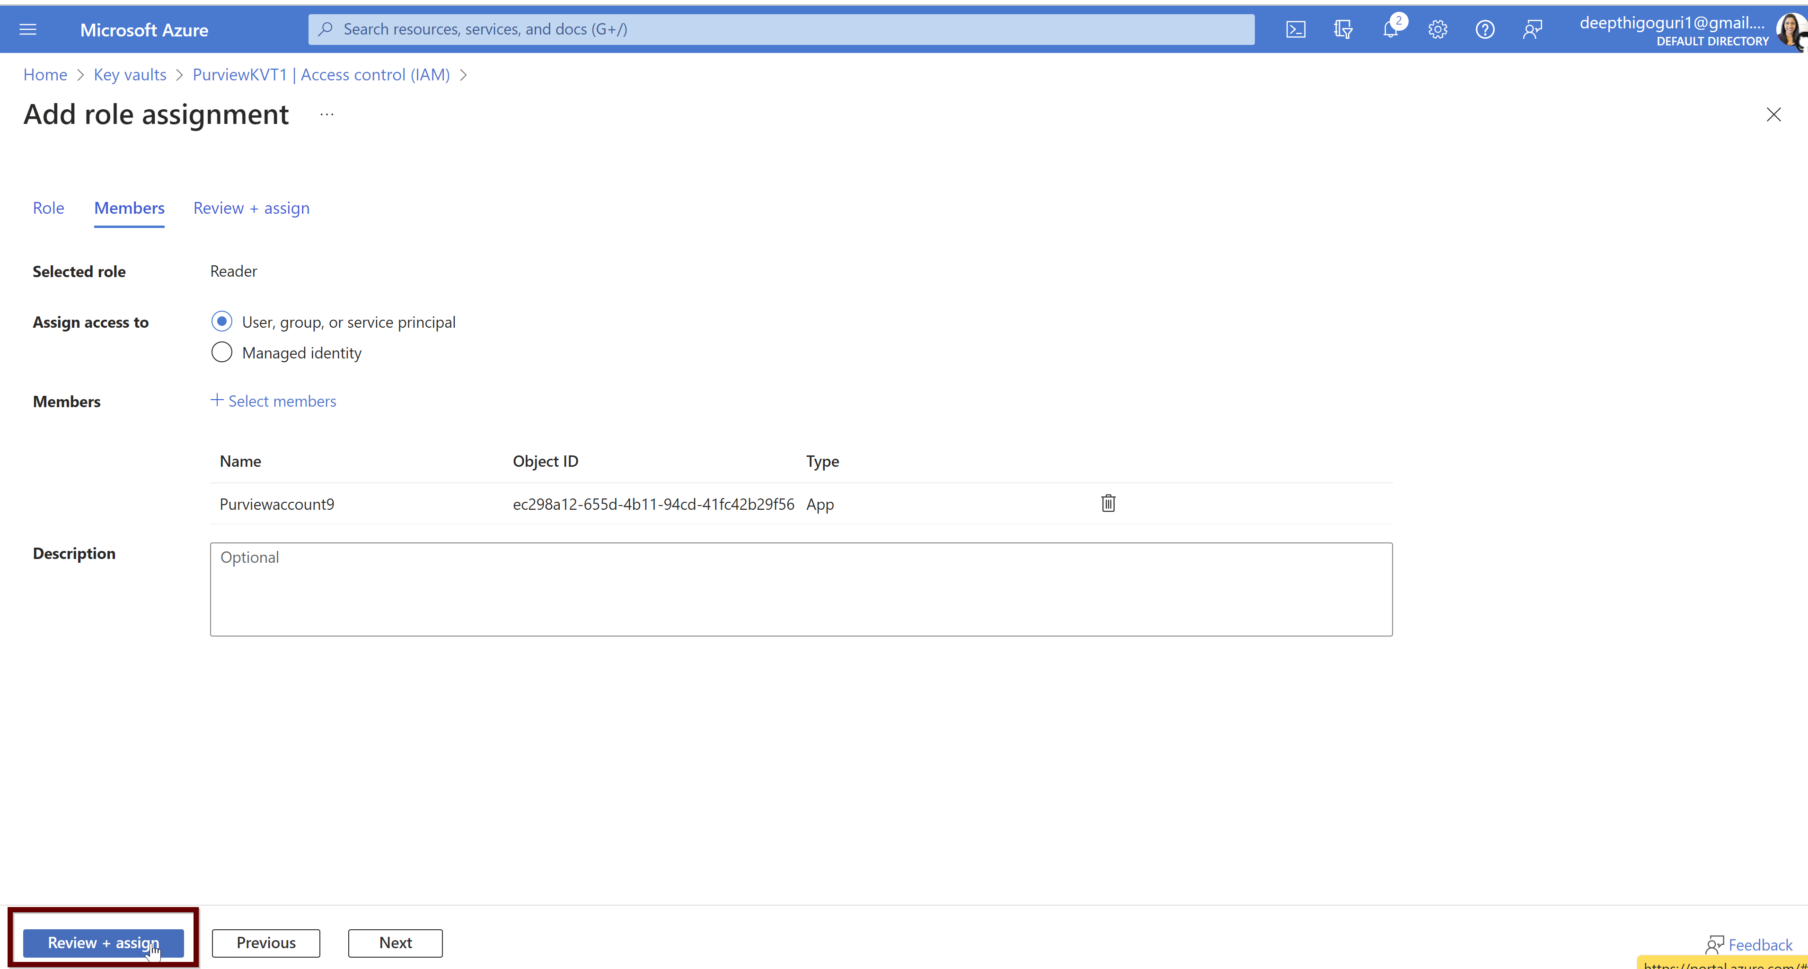

Slide 37
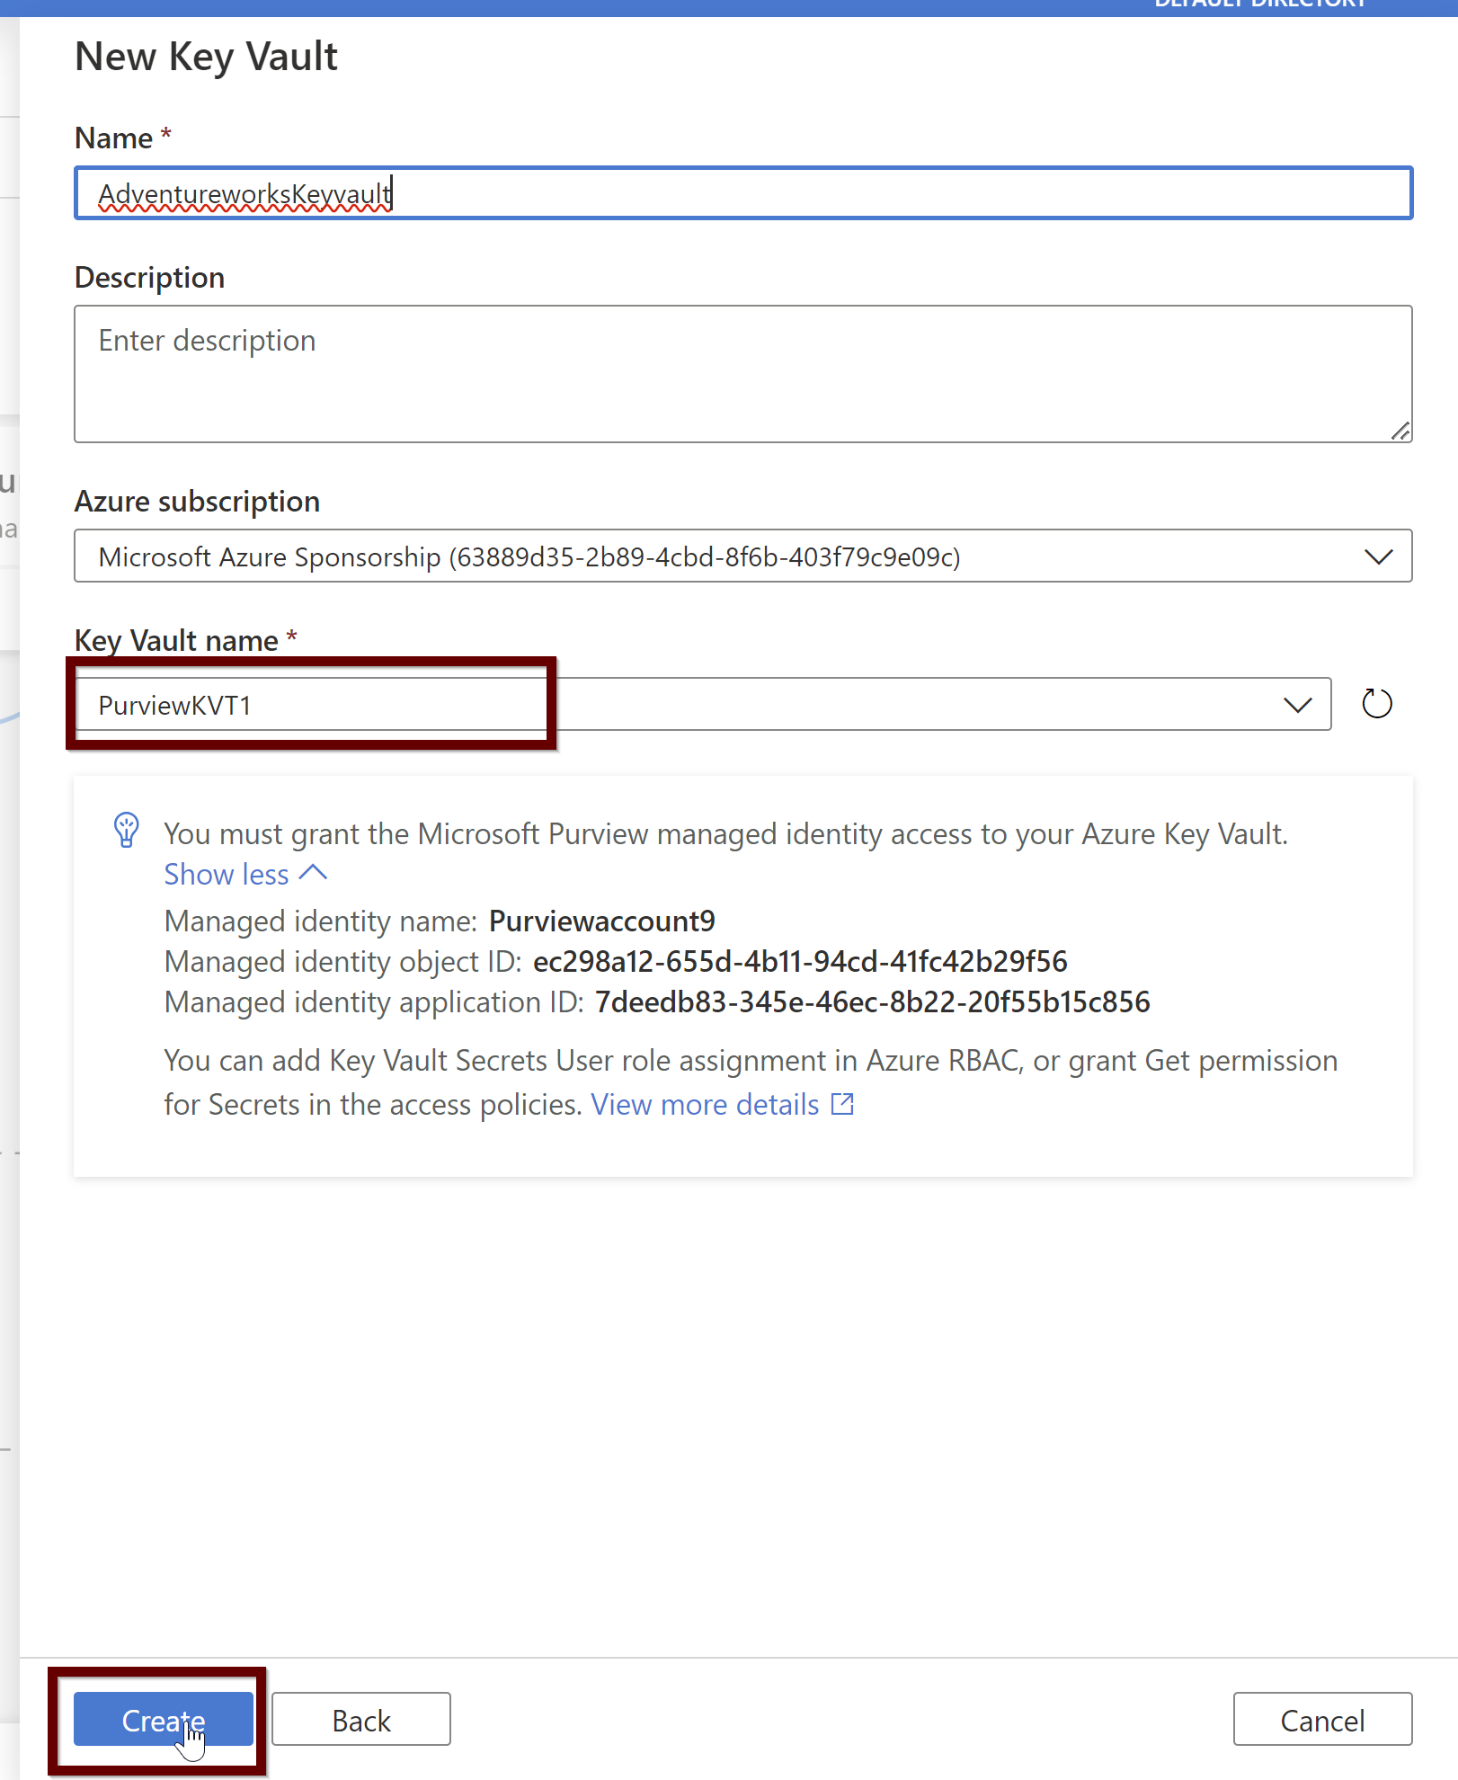

Slide 38
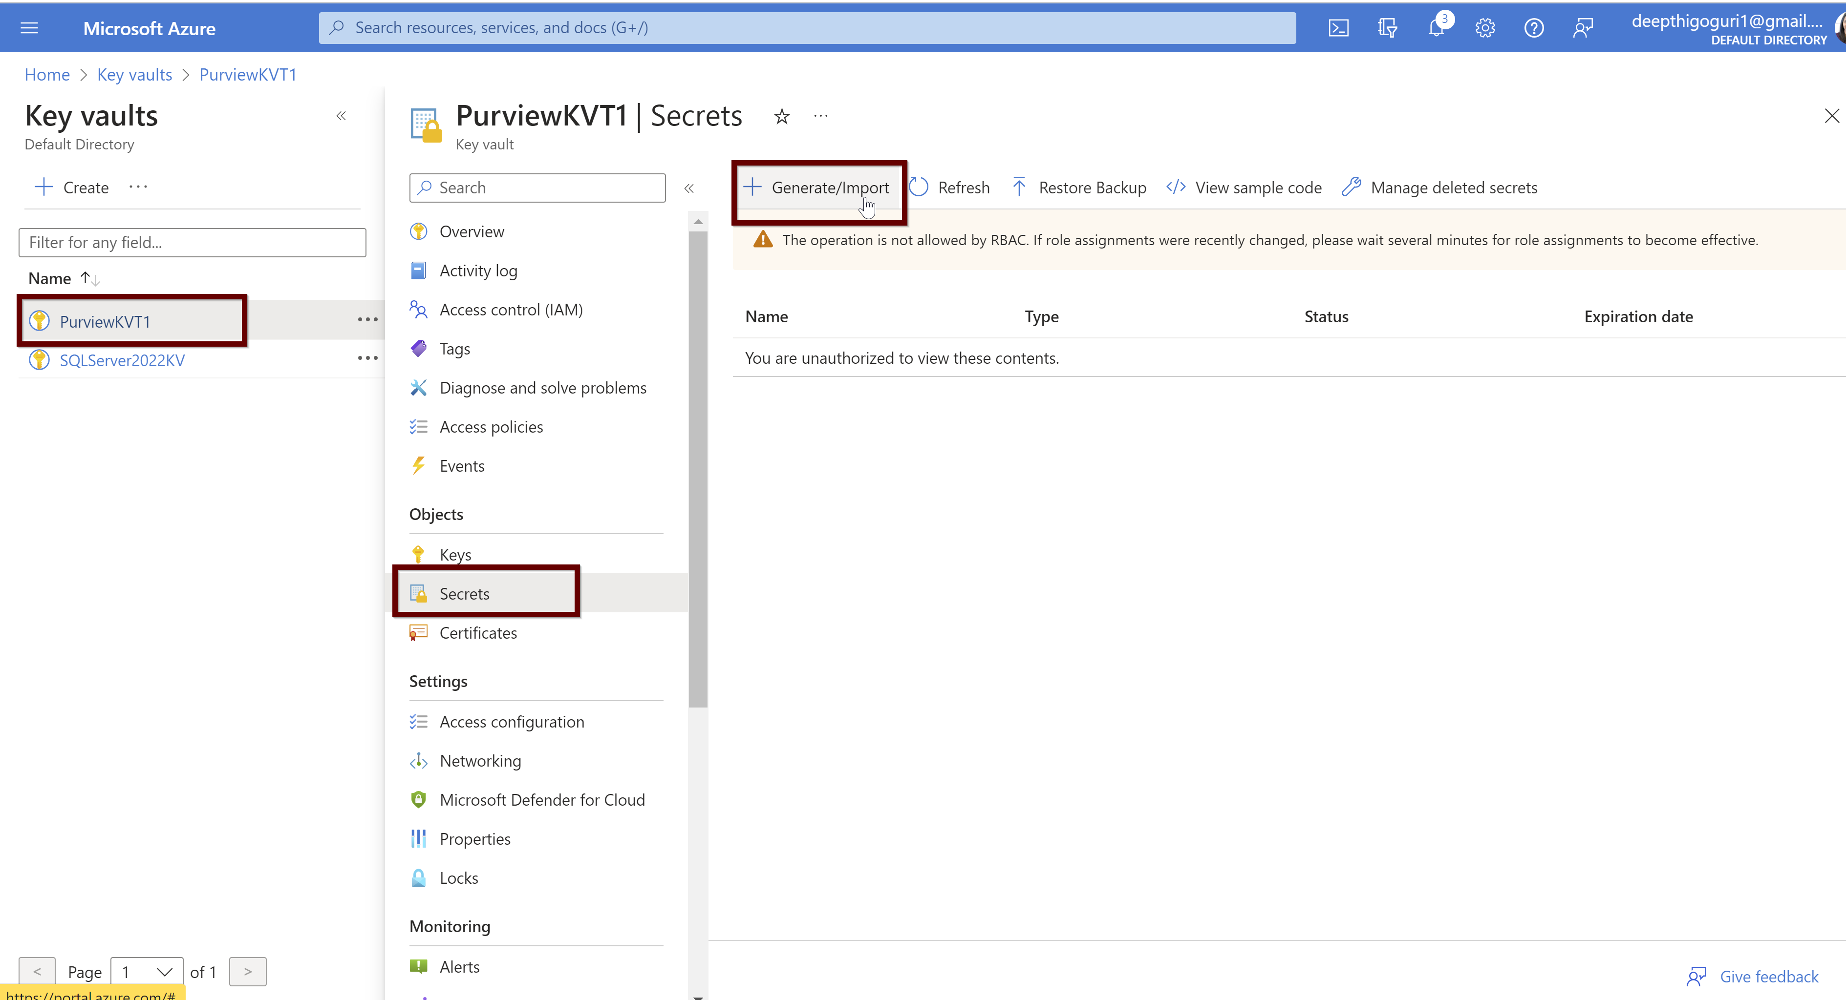

Slide 39
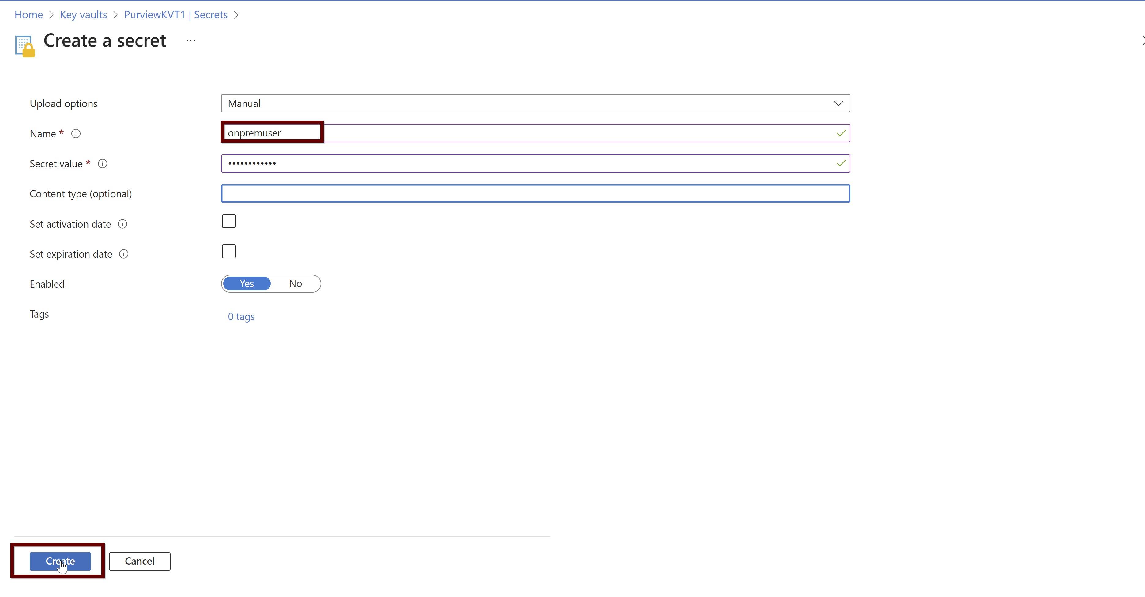

Slide 40
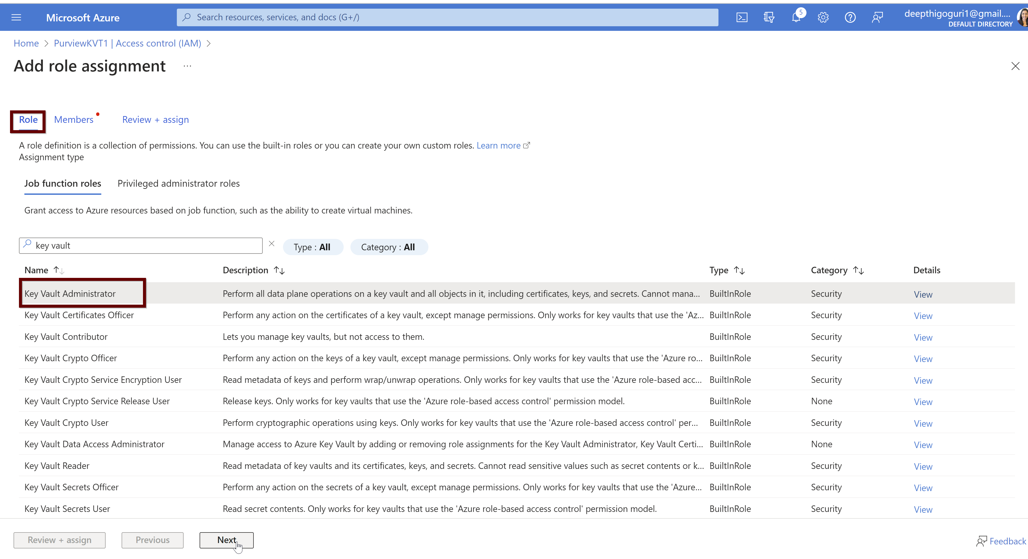

Slide 41
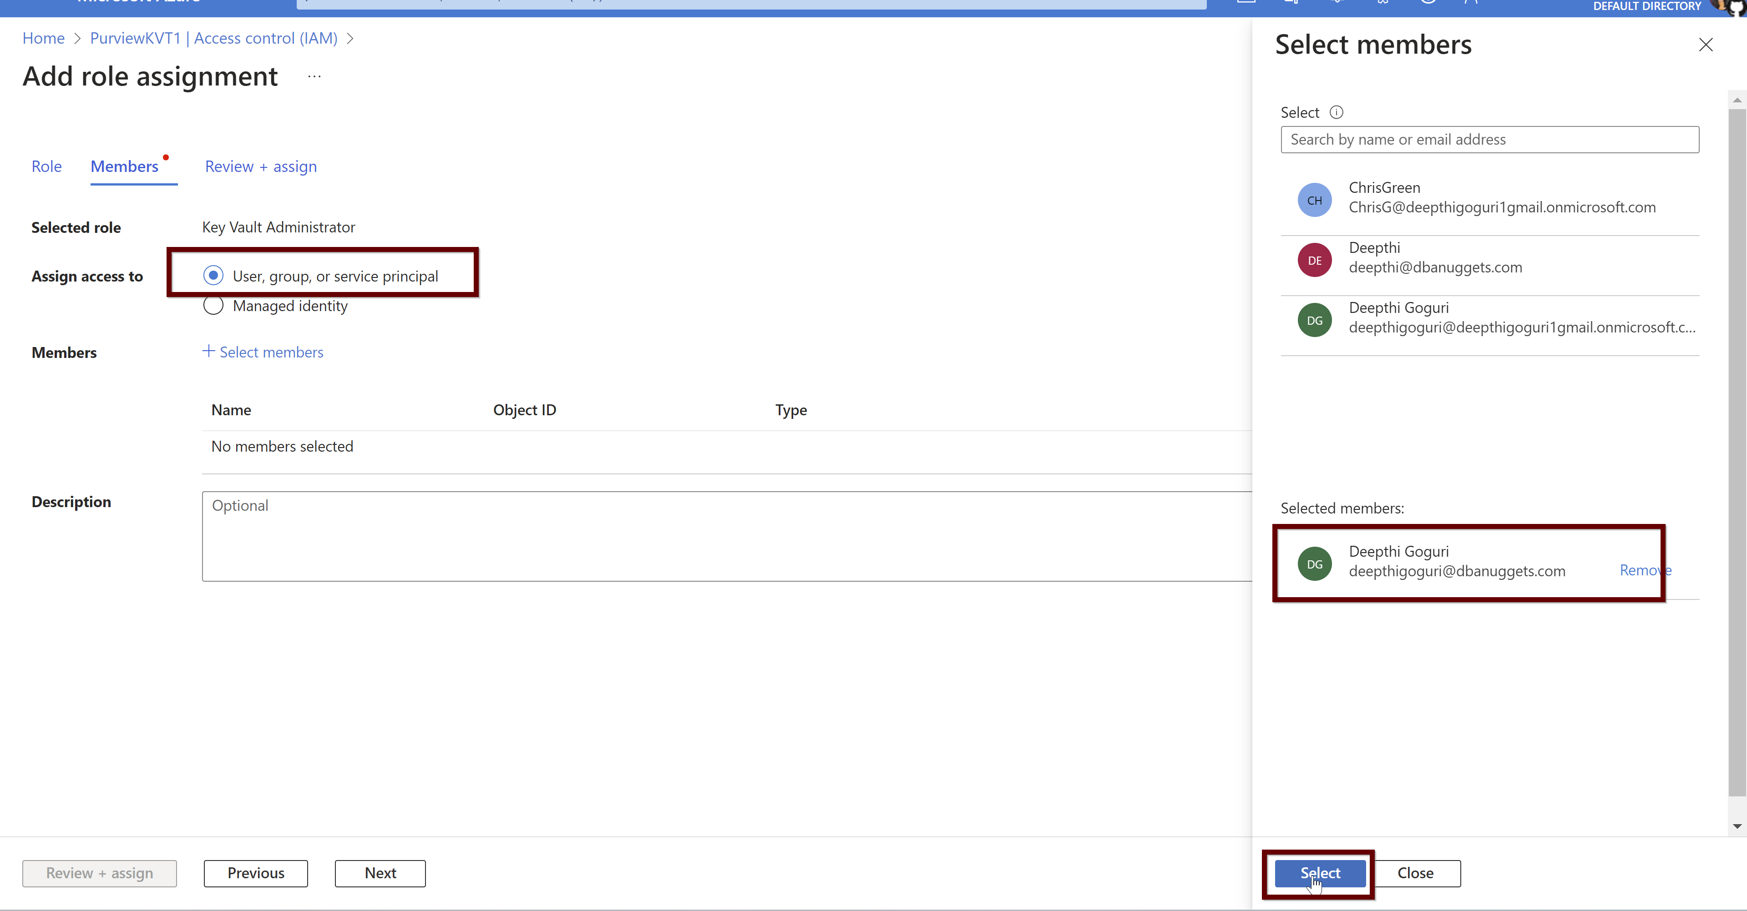

Slide 42
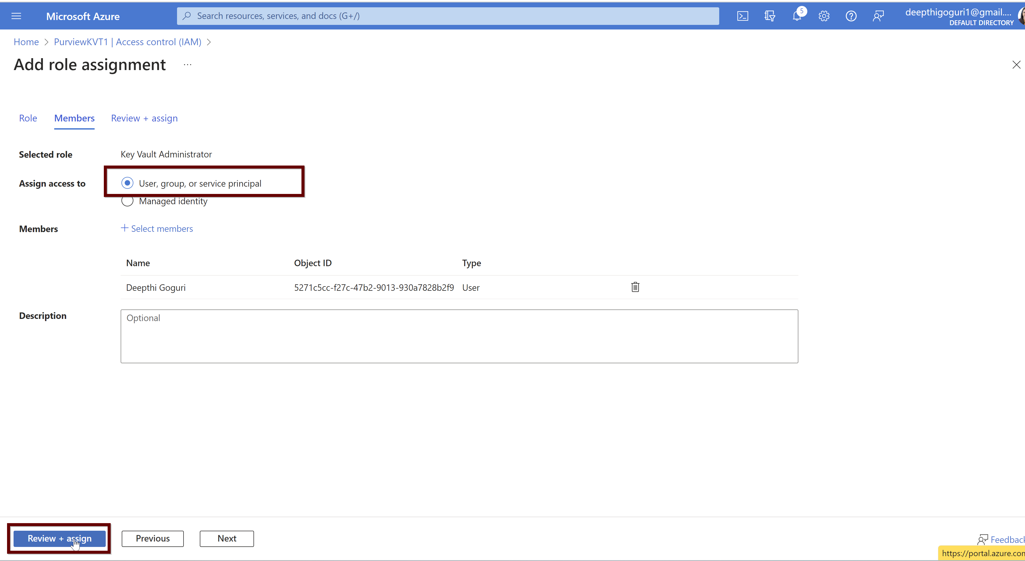

Slide 43
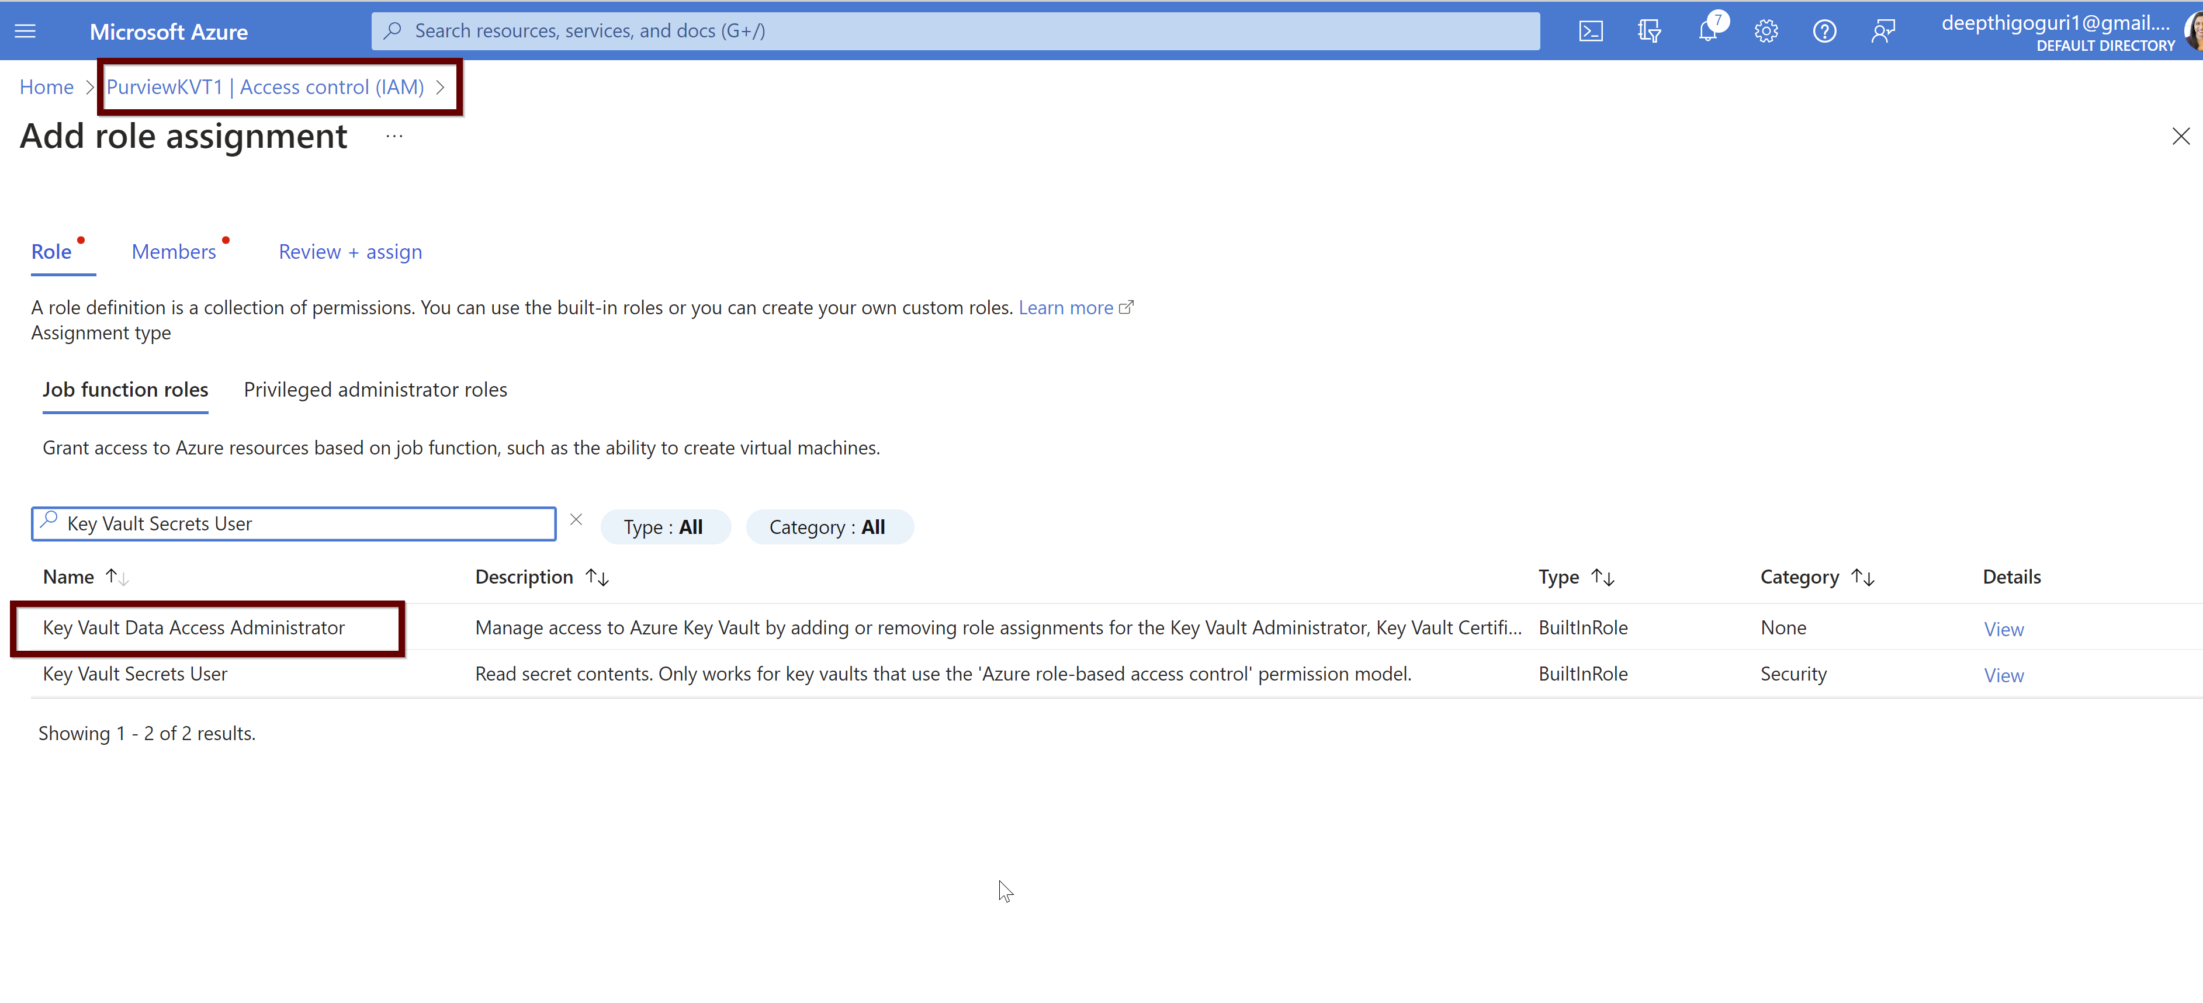

Slide 44
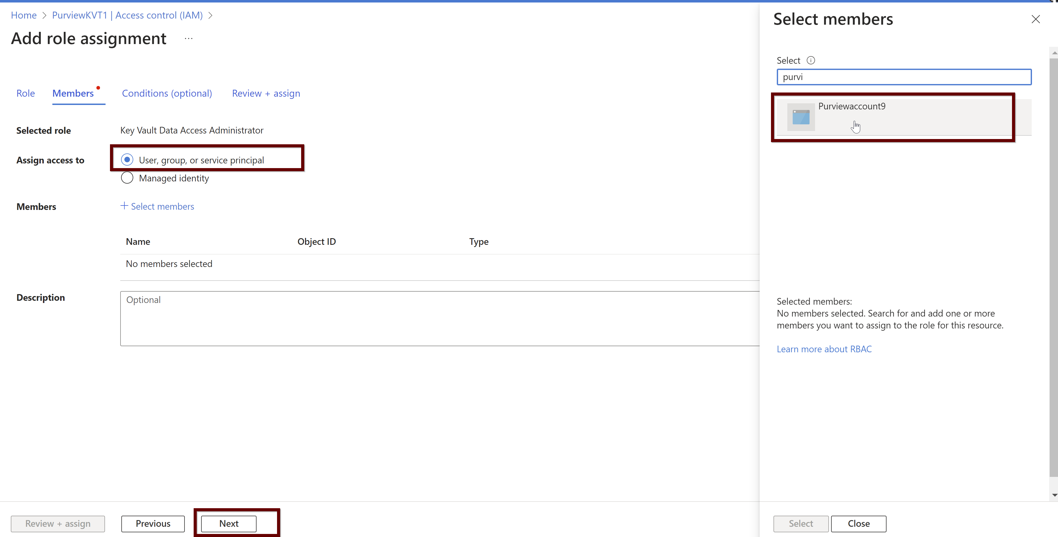

Slide 45
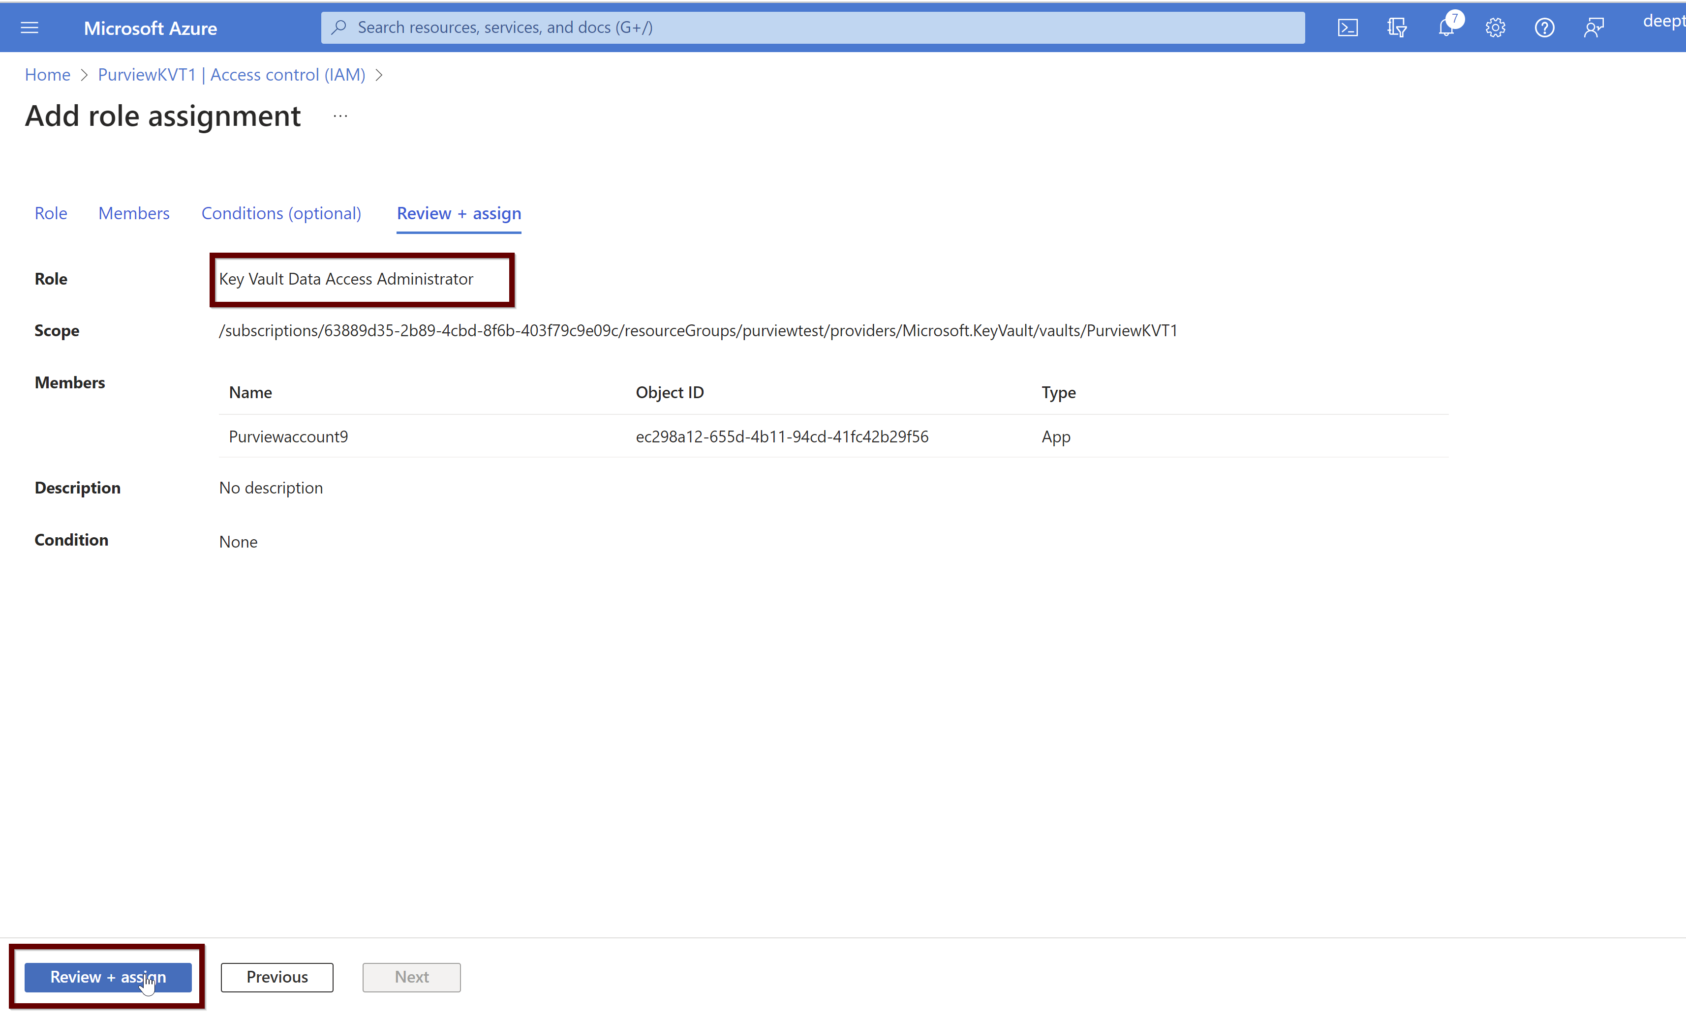

Slide 46
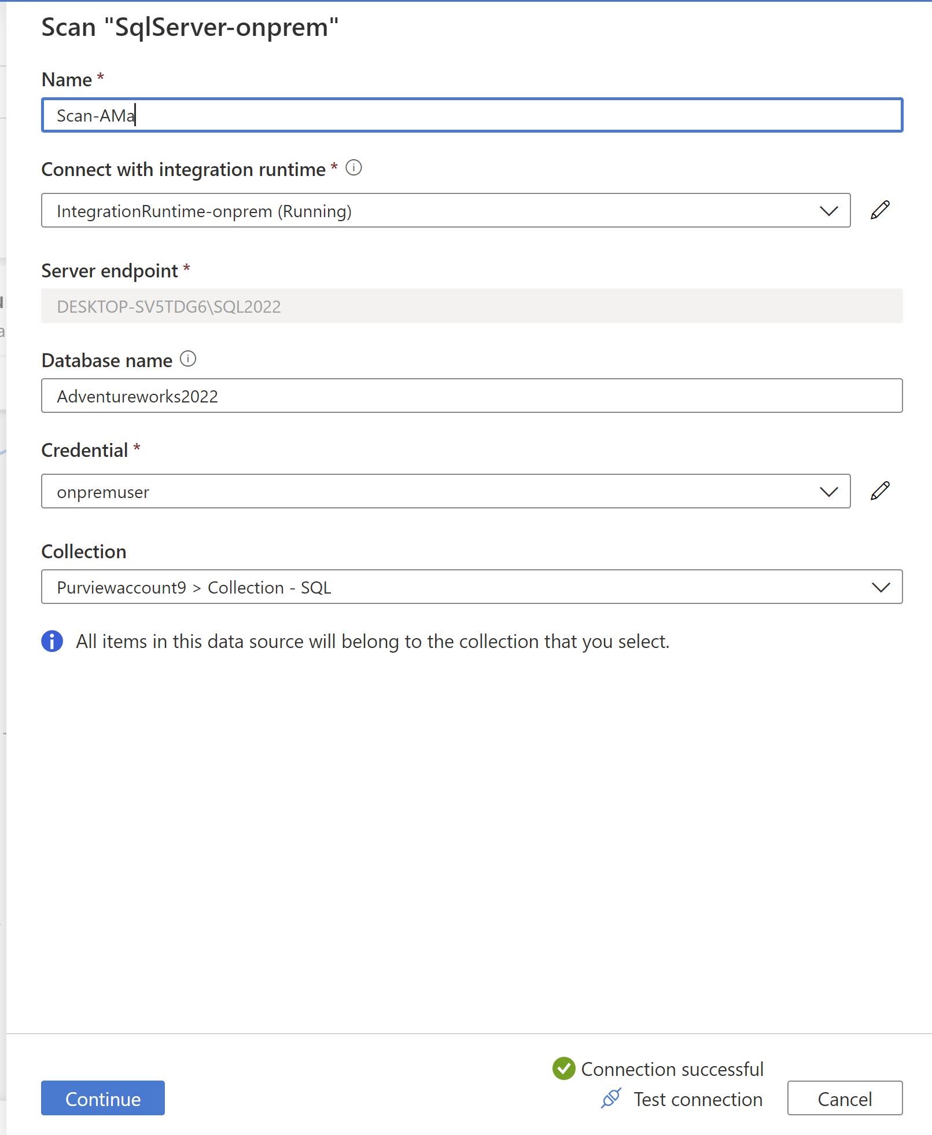

Slide 47
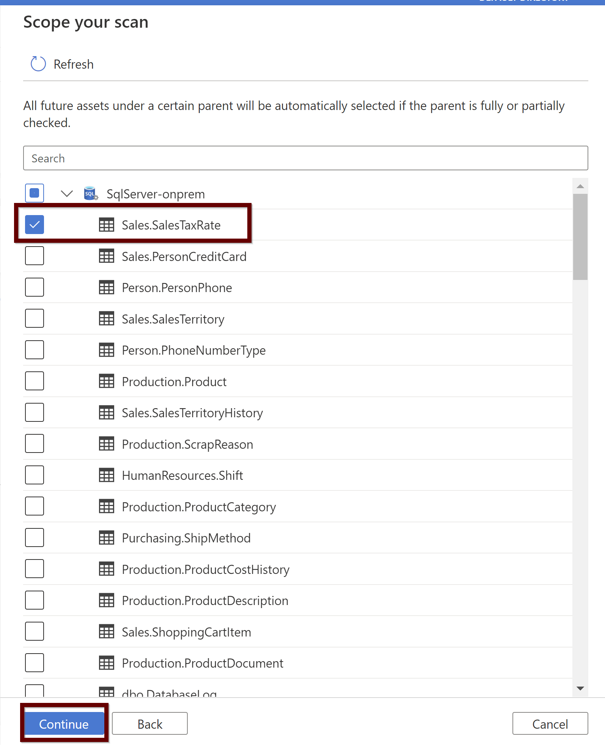

Slide 48
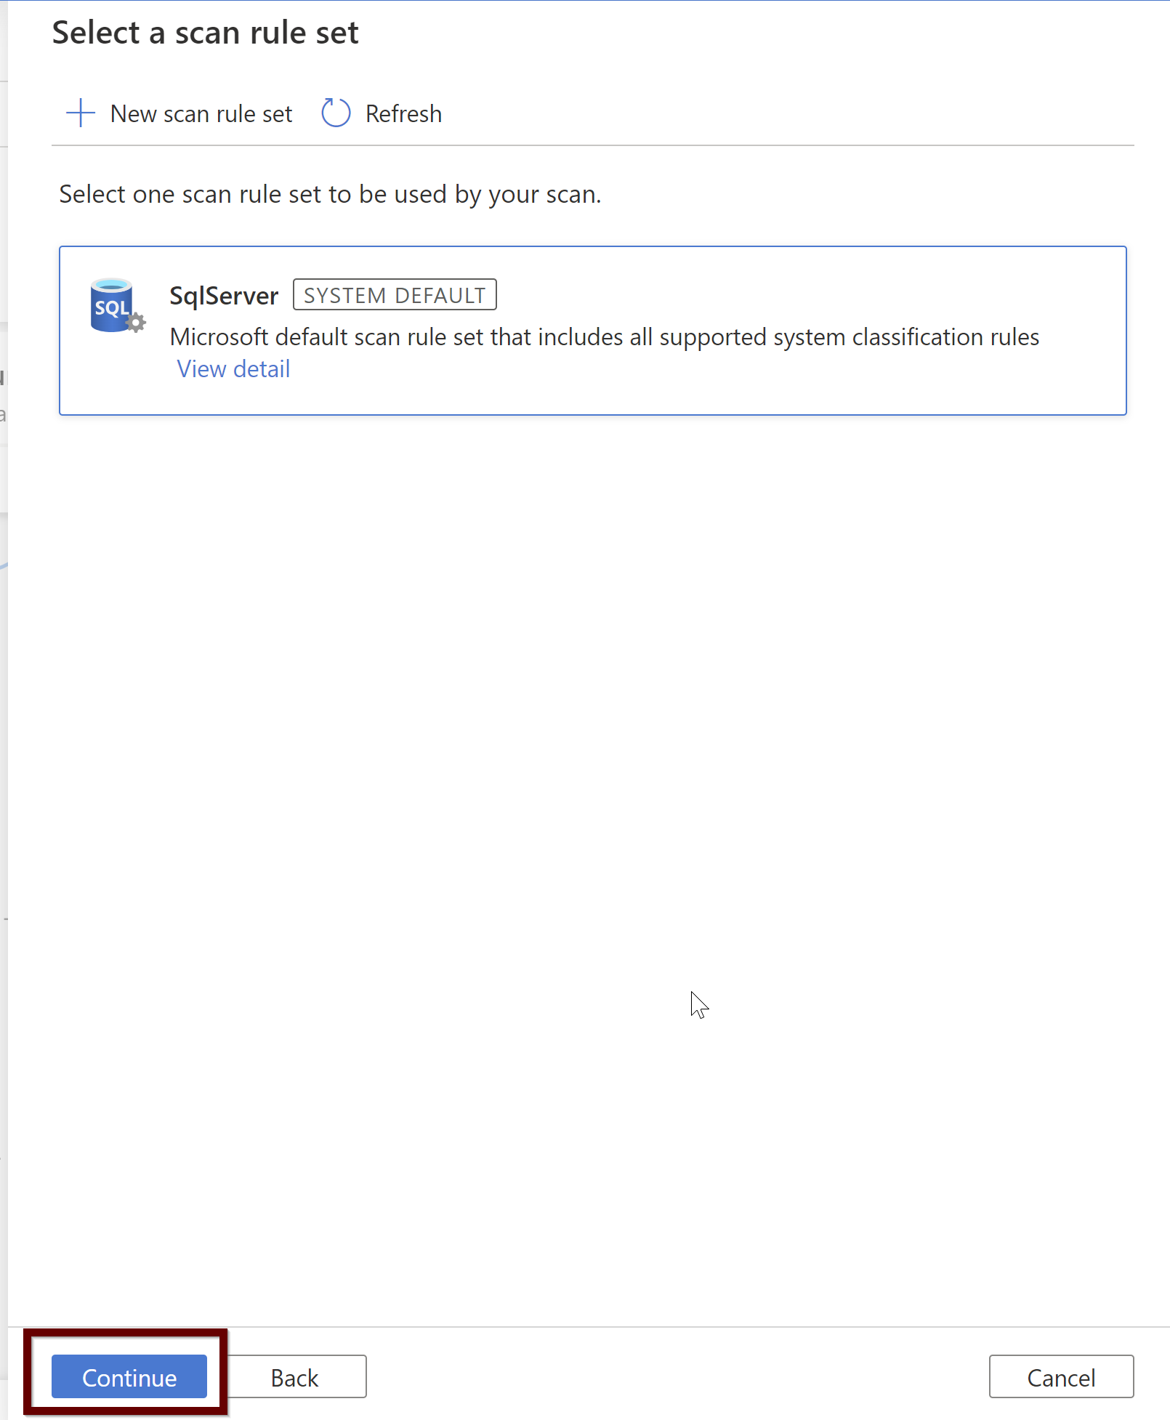

Slide 49
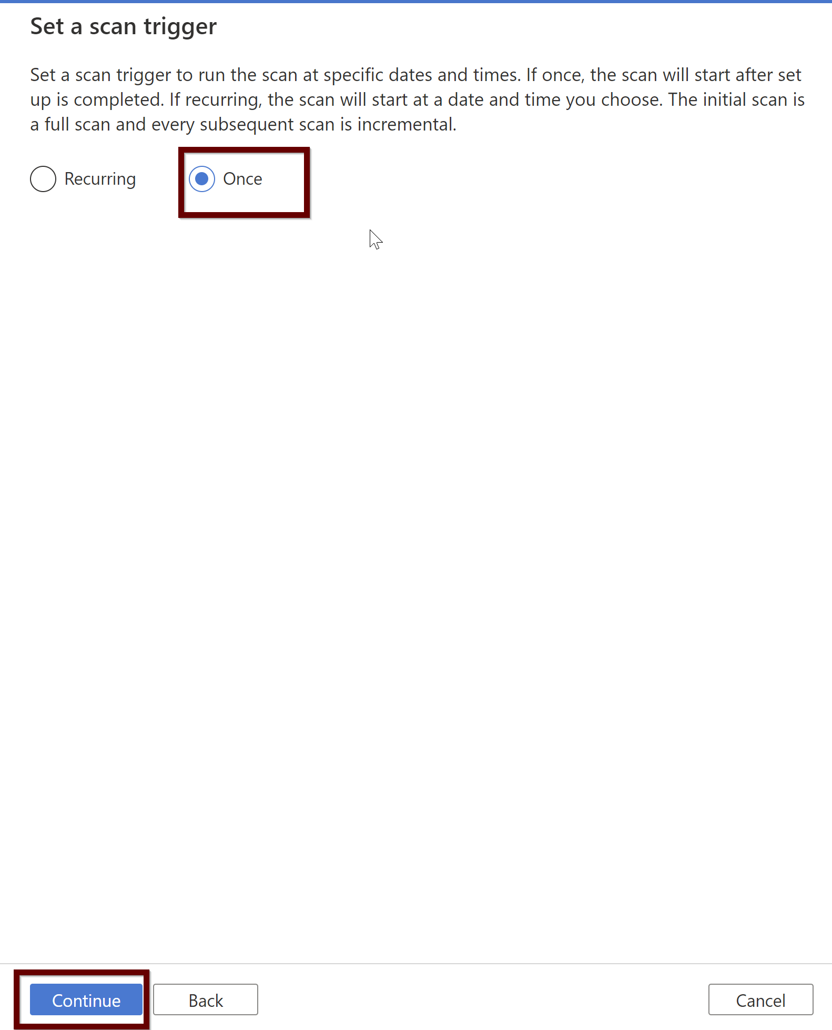

Slide 50
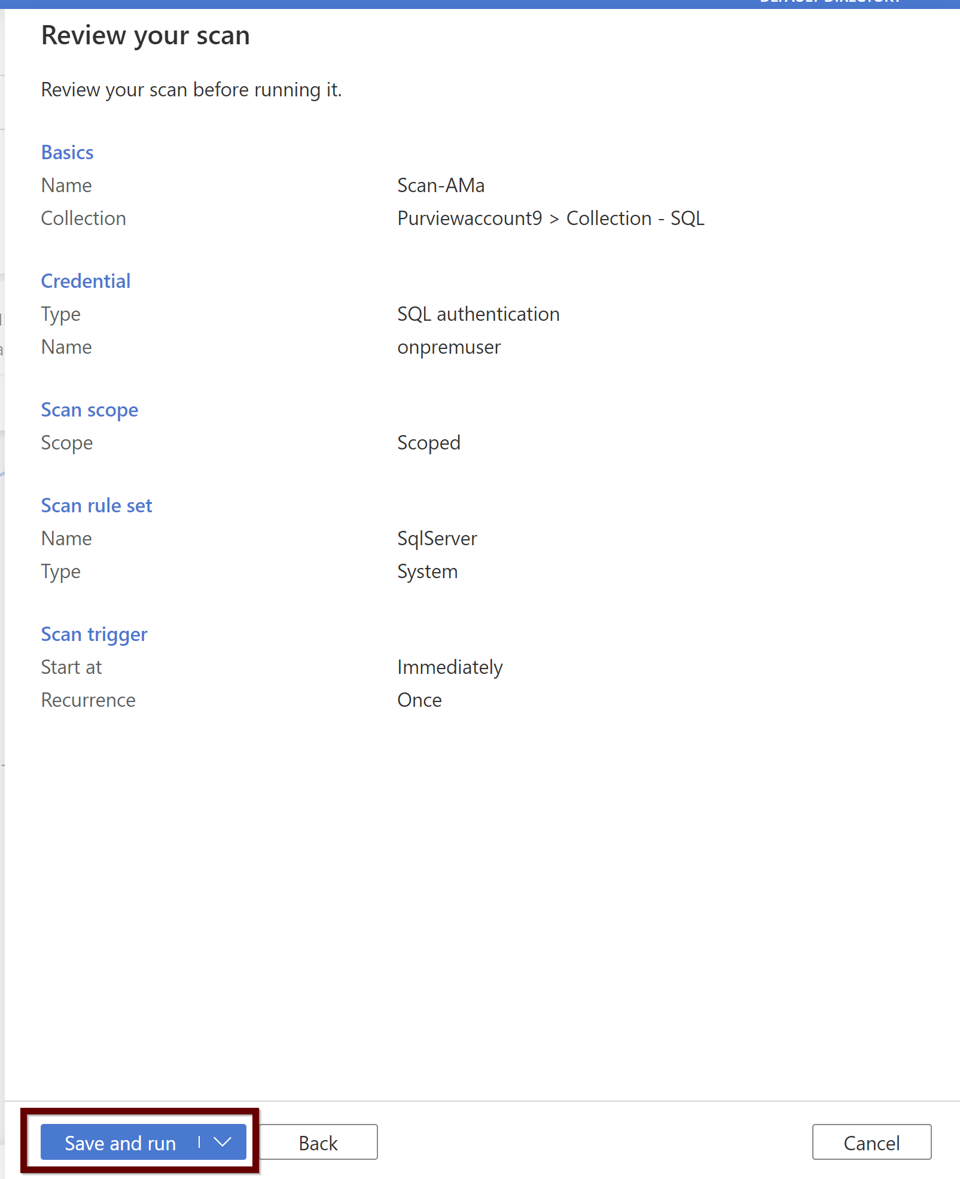

Slide 51
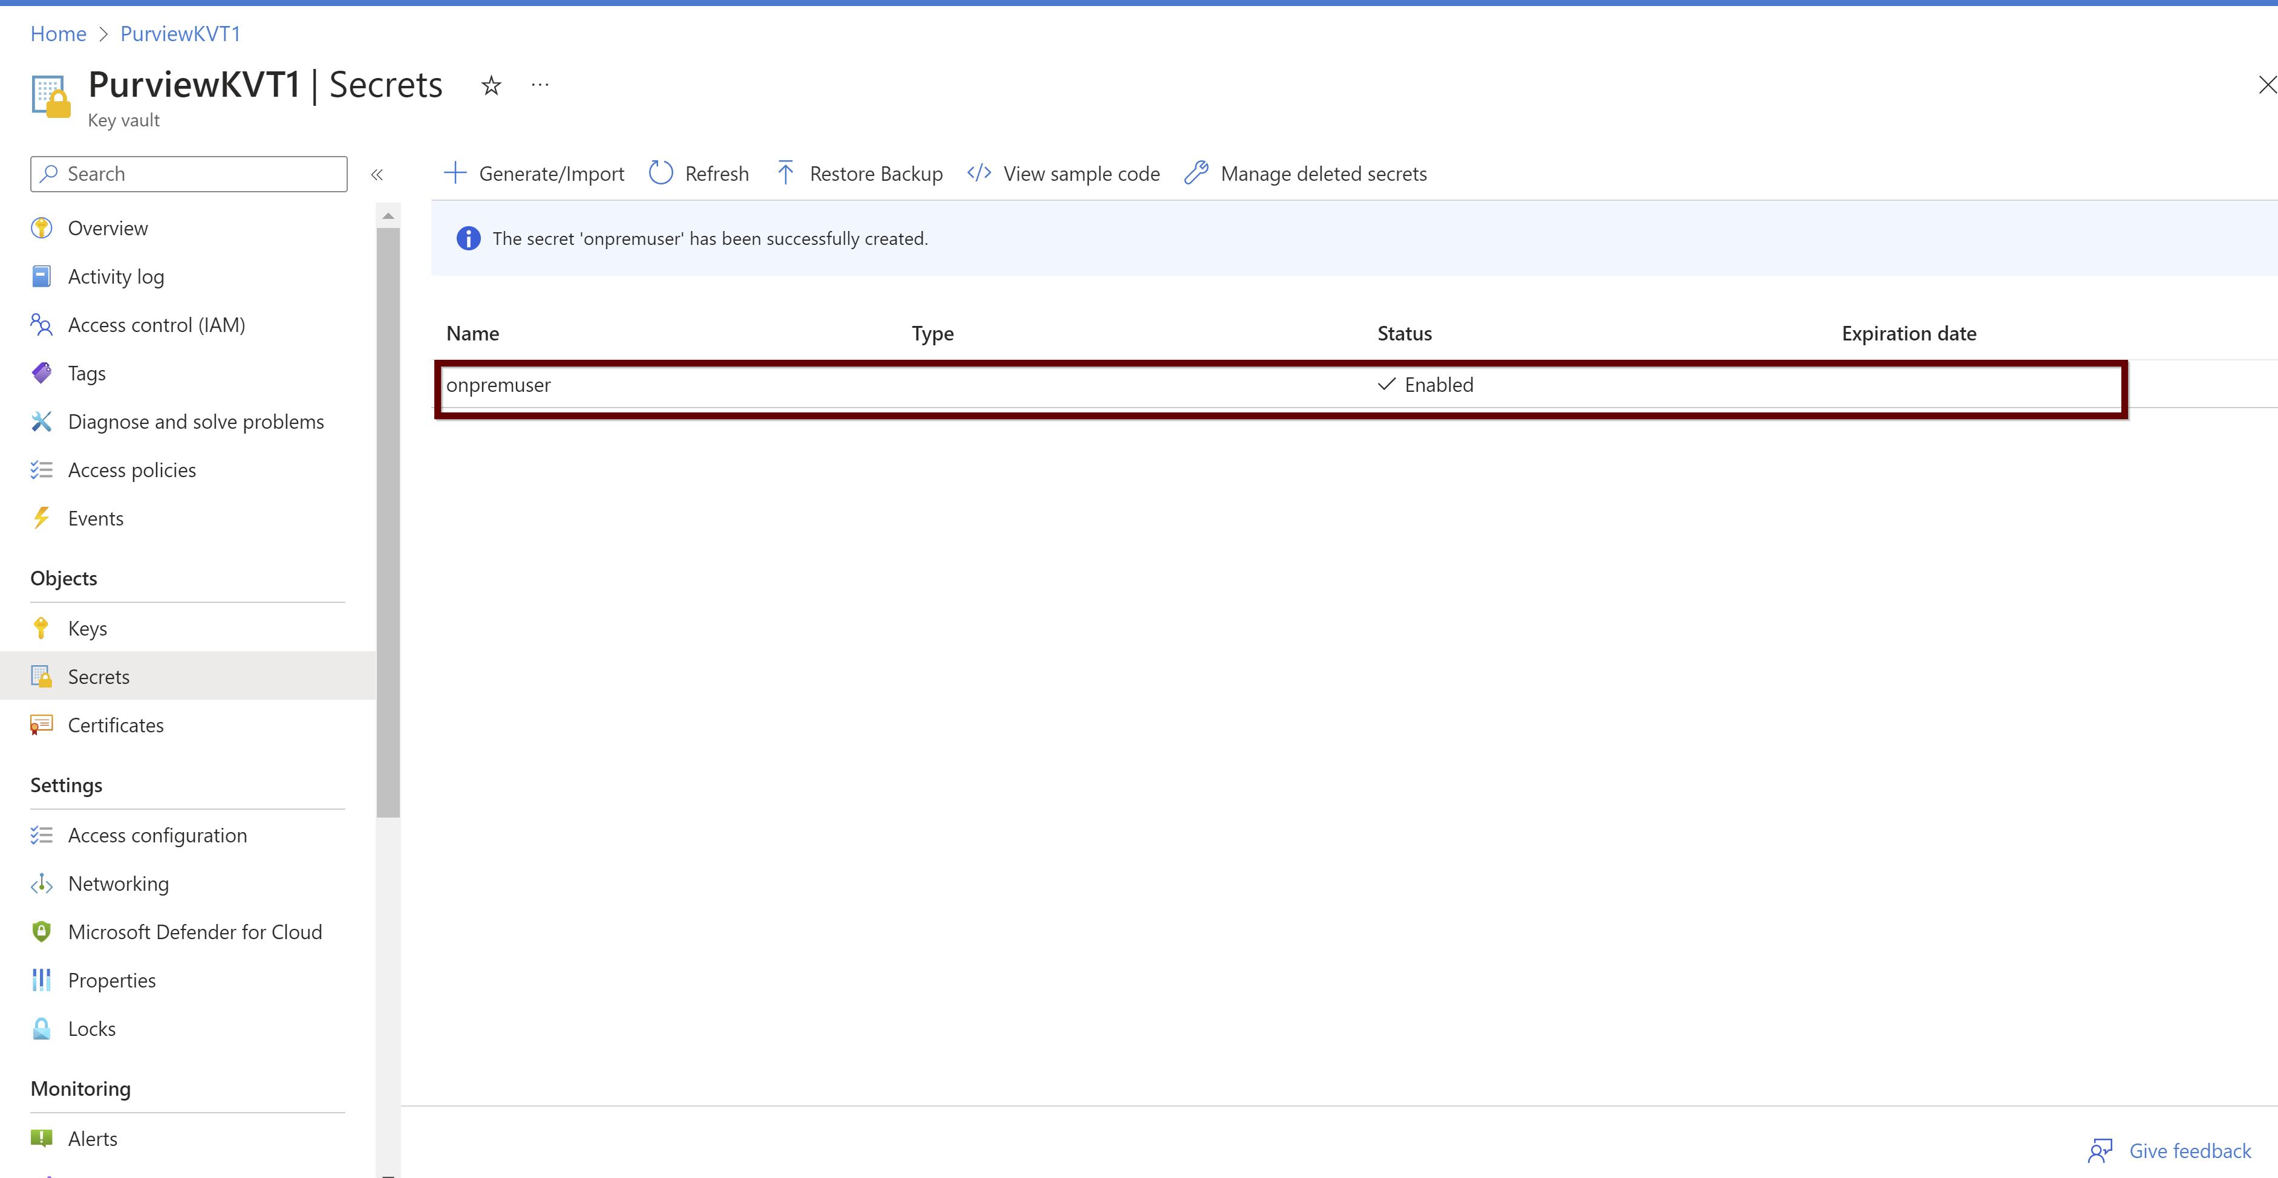

Slide 52
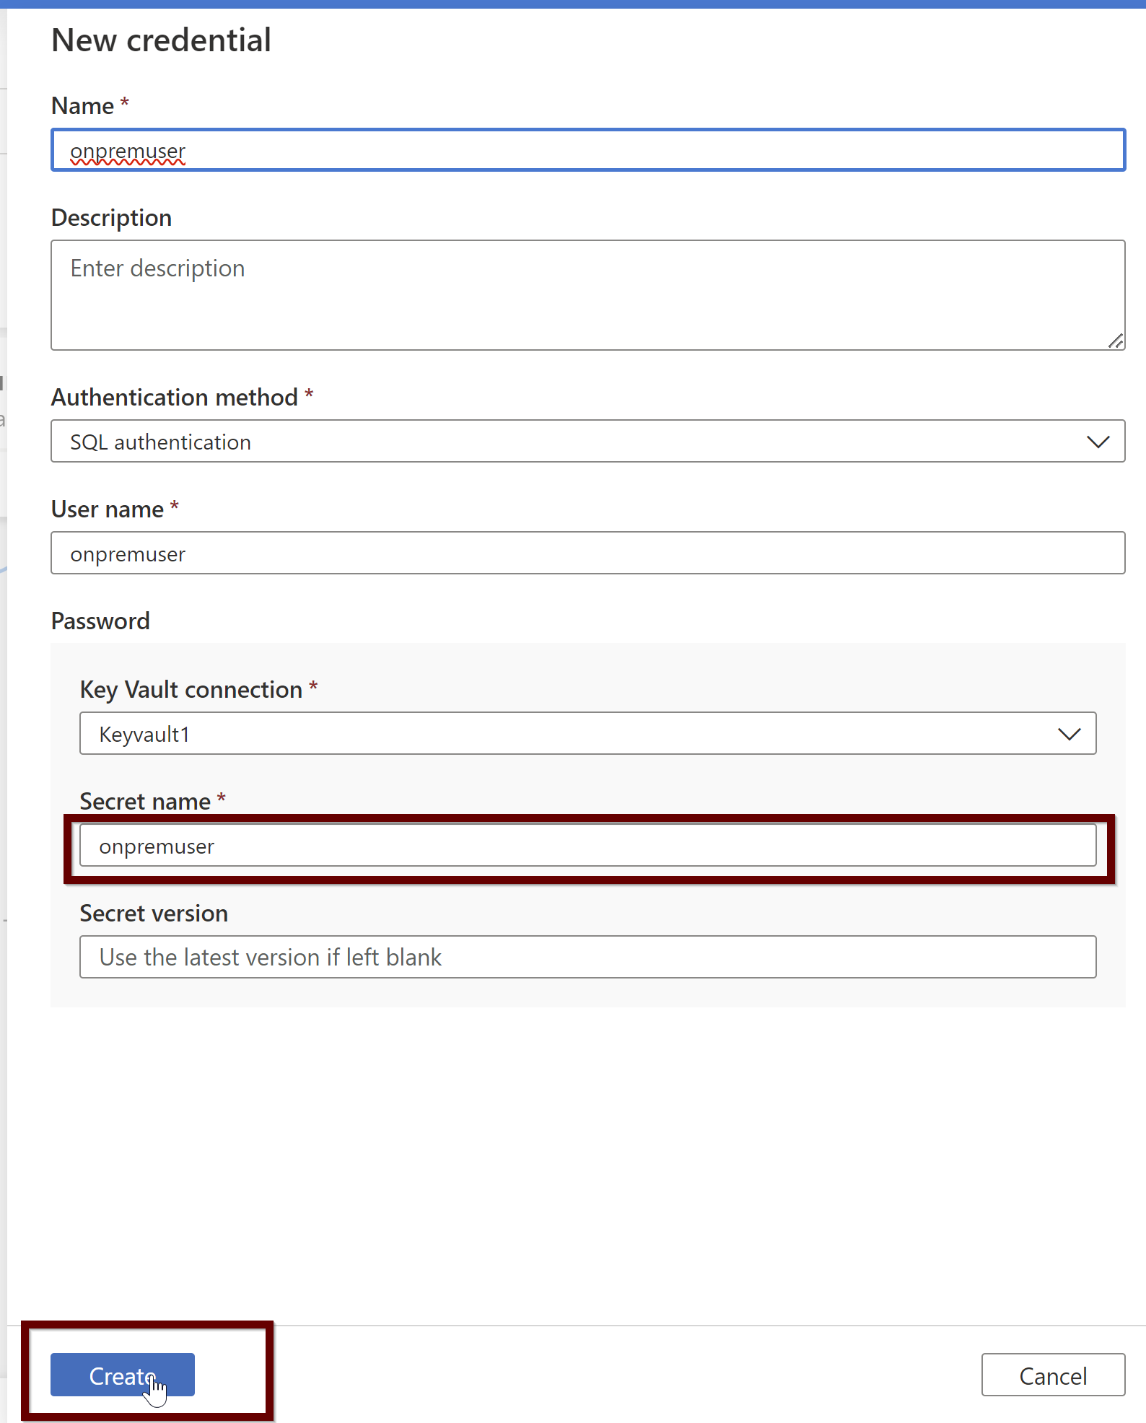

Slide 53
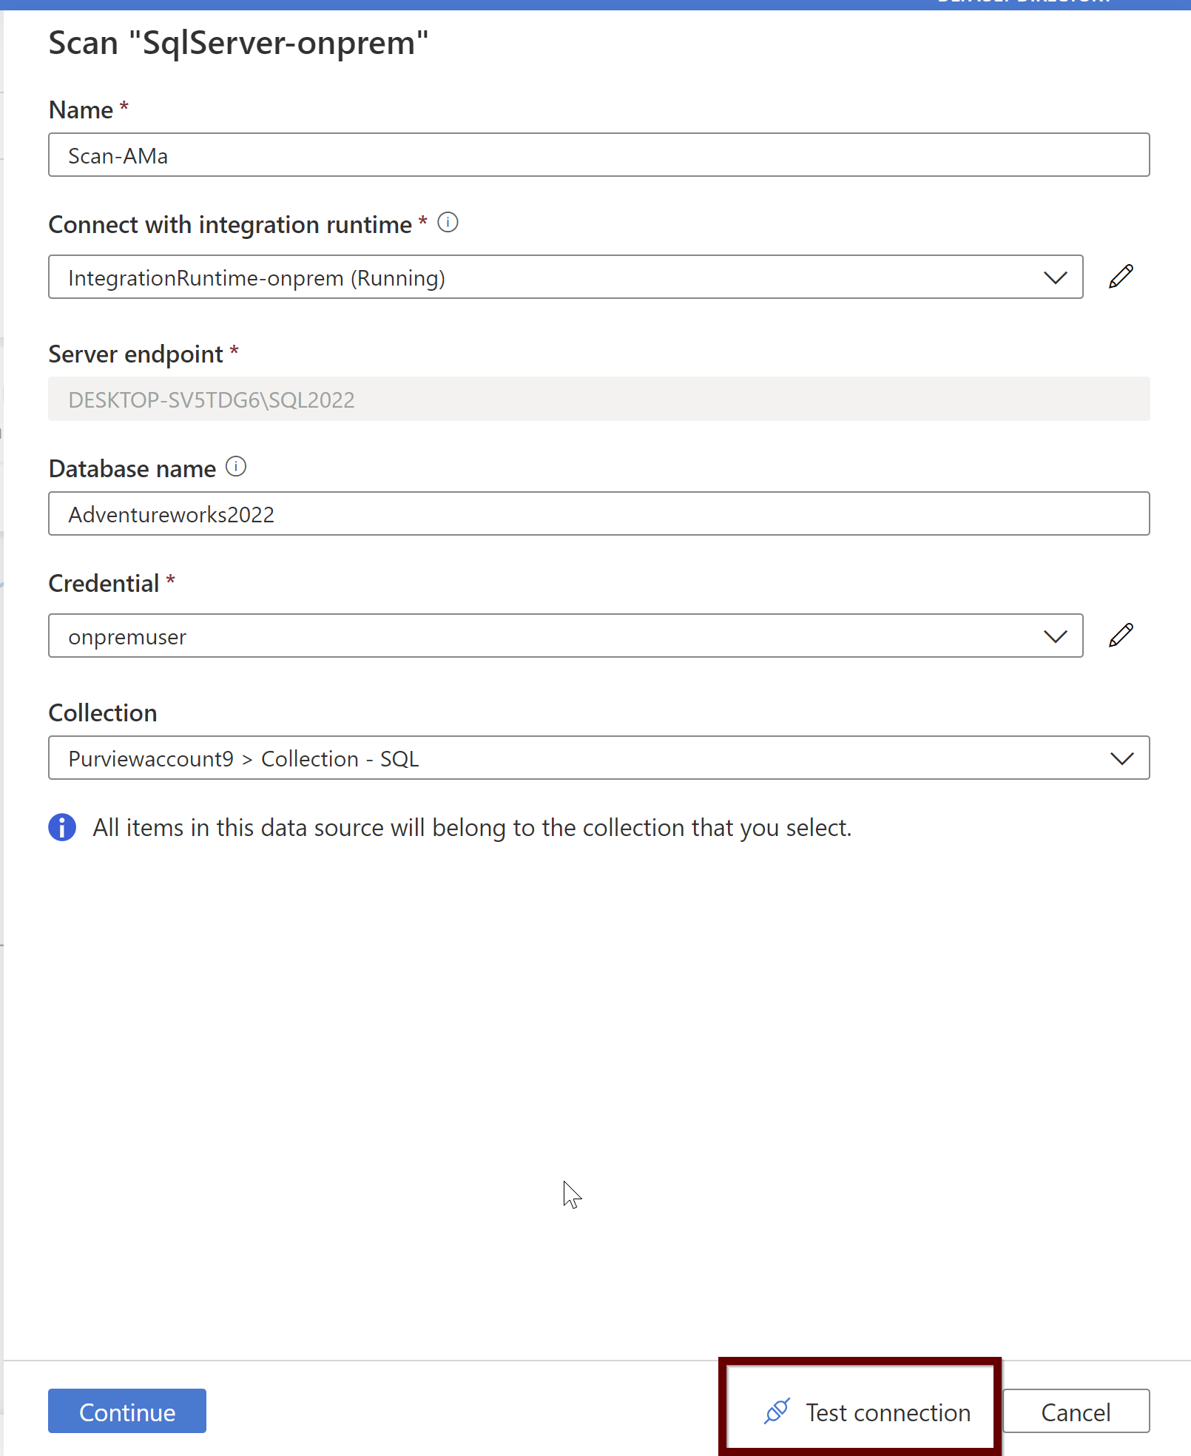

Slide 54
References
https://learn.microsoft.com/en-us/azure/data-factory/tutorial-push-lineage-to-purview
https://www.youtube.com/watch?v=eylcP2qDFic
https://learn.microsoft.com/en-us/purview/manage-credentials

